Slide 1



Visual Studio Mobile Center
99/4A
Ben Ishiyama-Levy
Microsoft MVP | Xamarin Evangelist
ben@xamariners.com
http://www.meetup.com/SingaporeMobileDev/

Slide 2
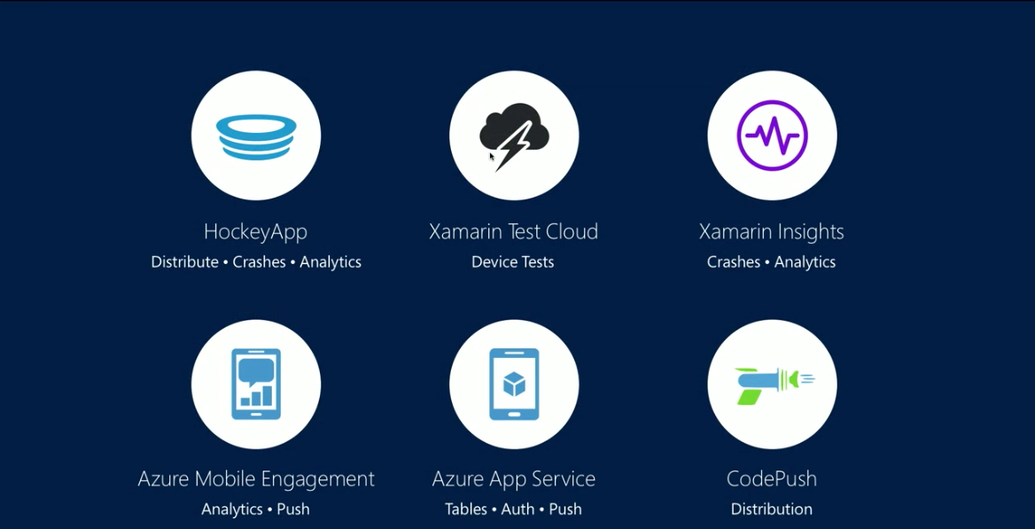

Slide 3

A brief history
HockeyApp
Acquired by Microsoft Dec 2014
Distribution | Crashes | Analytics
Name comes from iOS distribution ‘adHoc’ , being the ‘Key’ of the original open source project HockeyApp evolved from. (AdHoc is Key)

Slide 4

A brief history
Xamarin Test Cloud
Xamarin Acquired by Microsoft Feb 2016
Automated 2000+ Device Tests
Evolved from mobile app acceptance tests Calabash. Supports Cucumber

Slide 5

A brief history
Xamarin Insights
Xamarin Acquired by Microsoft Feb 2016
Crashes | Analytics
Merged with Hockey App

Slide 6

A brief history
Azure Mobile Engagement
Released on Azure Feb 2015
Analytics | Push

Slide 7

A brief history
Azure App Service
Released on Azure
Tables | Auth | Push
Composed of existing Azure offerings Web App + Mobile App and added Logic + Workflow App and API App

Slide 8

A brief history
CodePush
Open Source project Sep 2015
Distribution
Enables Cordova and React Native developers to deploy mobile app updates directly to their users’ devices

Slide 9
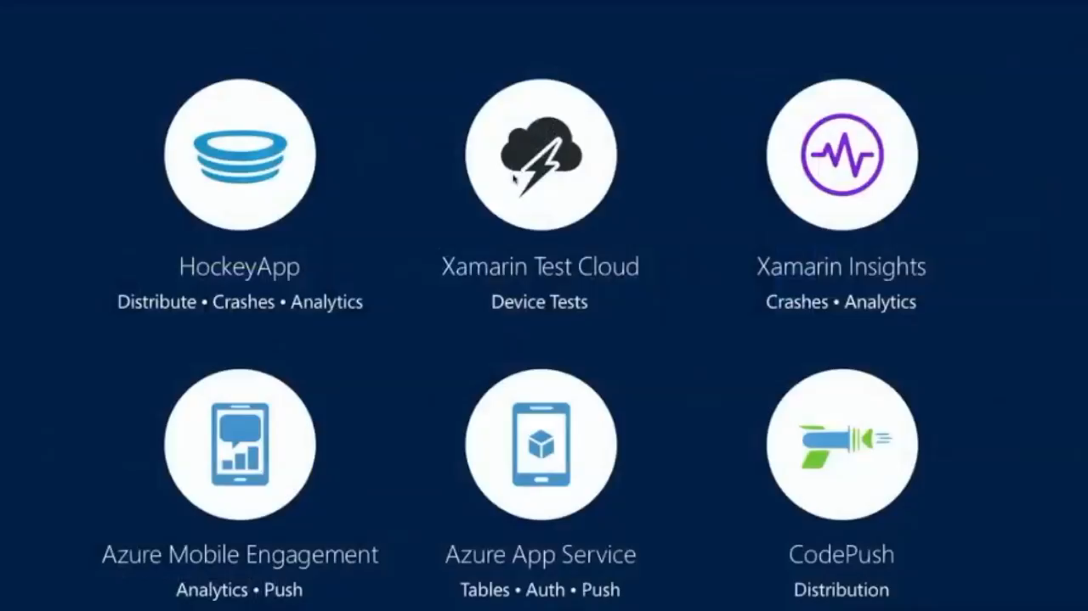

Slide 10

One Portal
Consolidation of acquired platforms, azure apps and open source projects
Microsoft branding
Everything mobile related under one umbrella
No longer need to use 6 different portals
Mix and match services

Slide 11
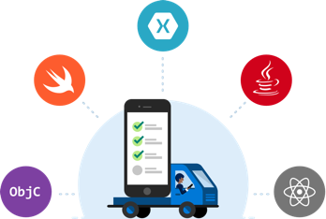
Features
Mobile platforms:
Objective-C, Swift, Java, Xamarin, React Native
Lifecycle features:
Build, Test, Crash, Beta Distribution, Analytics
Cloud features:
Authentication, Easy tables, Offline sync

Slide 12
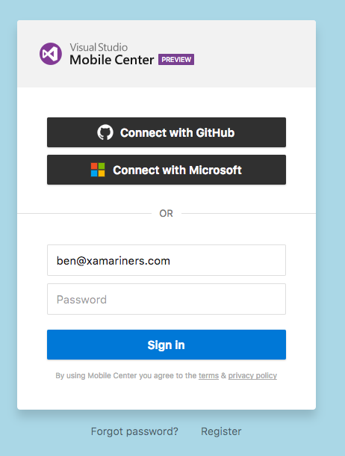
Sign-In
Currently in preview & completely free
Go to: https://mobile.azure.com/login
Existing HockeyApp users can use their existing credentials to sign-in
Microsoft and GitHub accounts also available

Slide 13
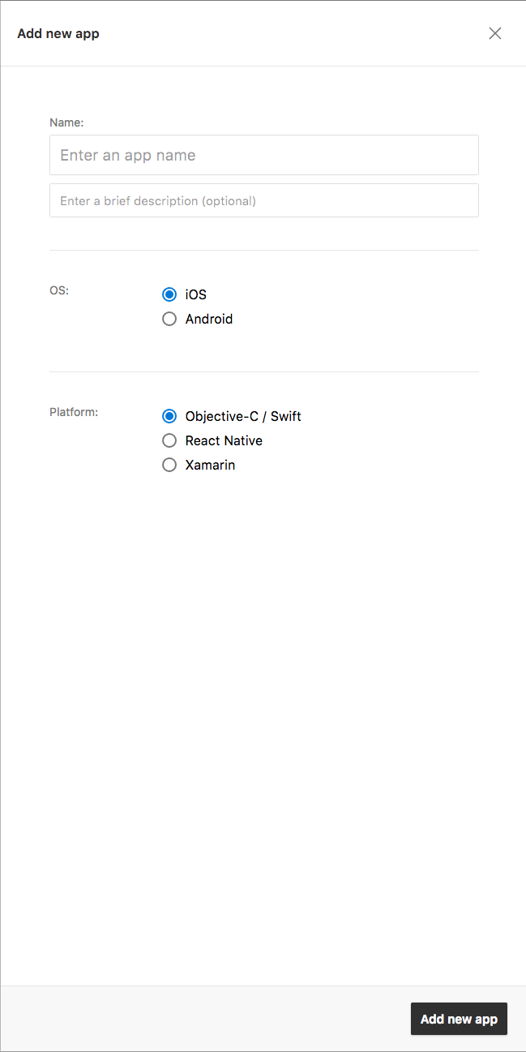
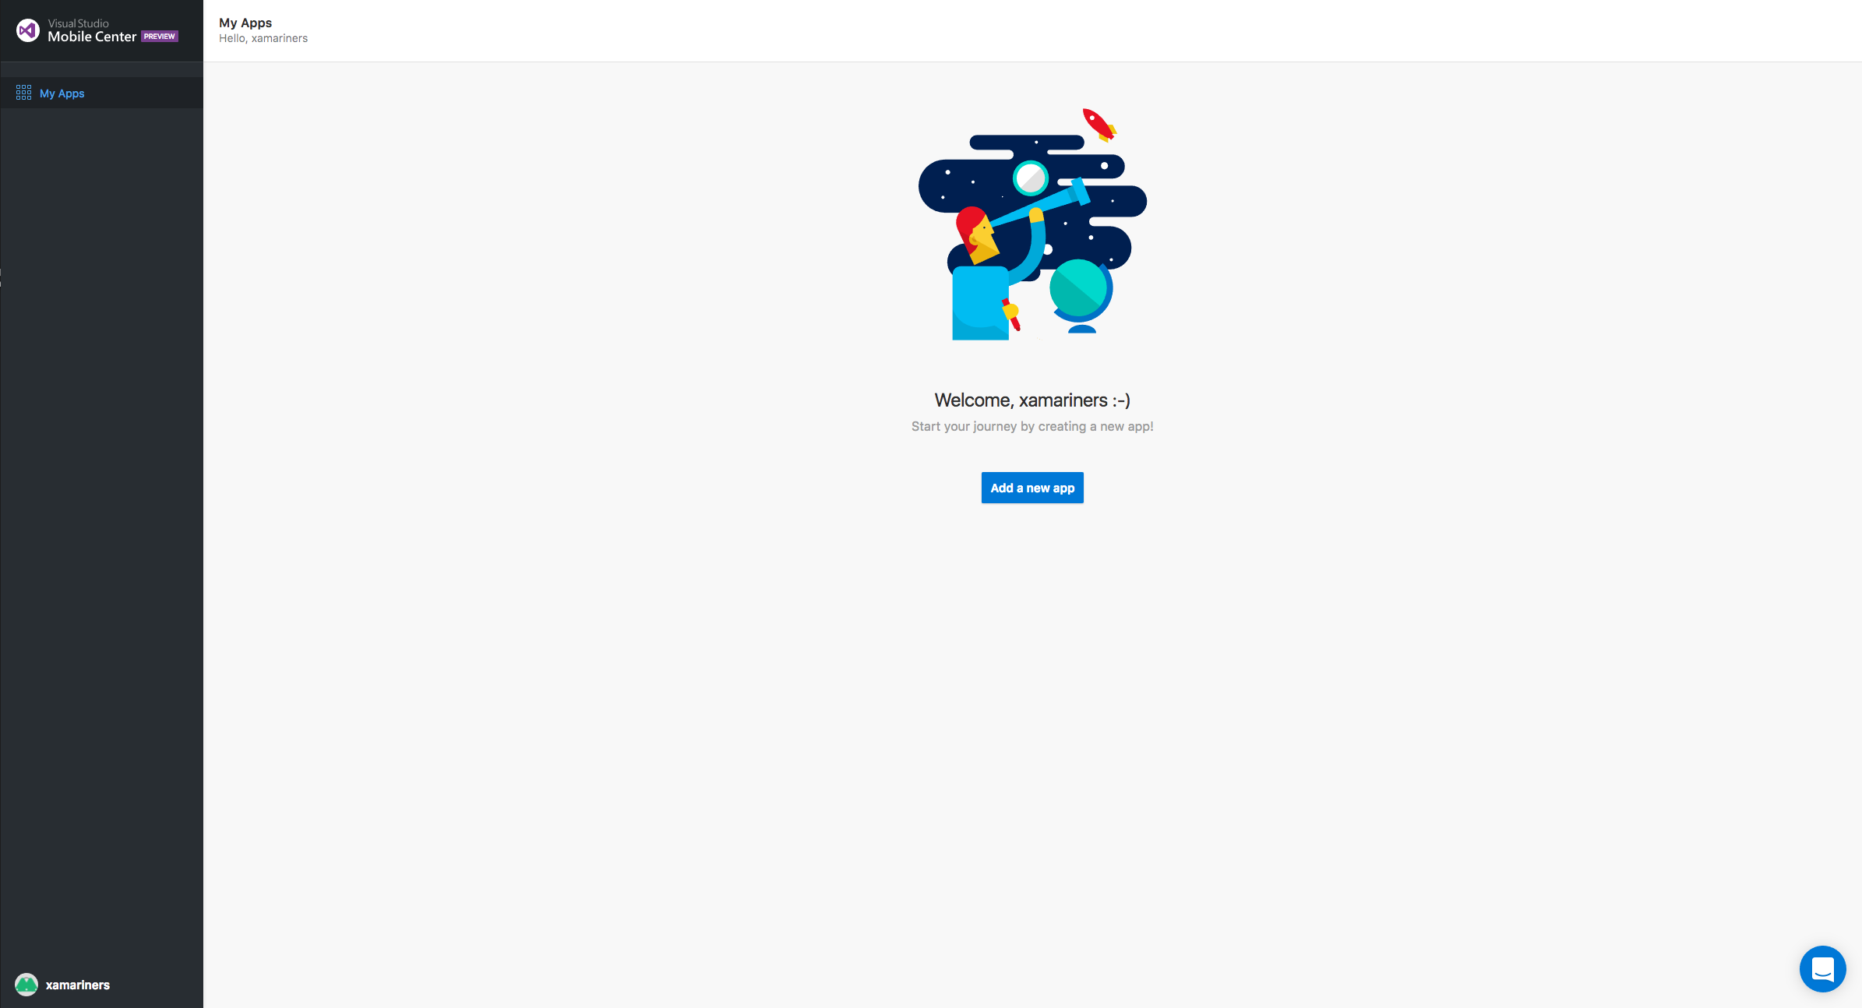
Create an app

Slide 14
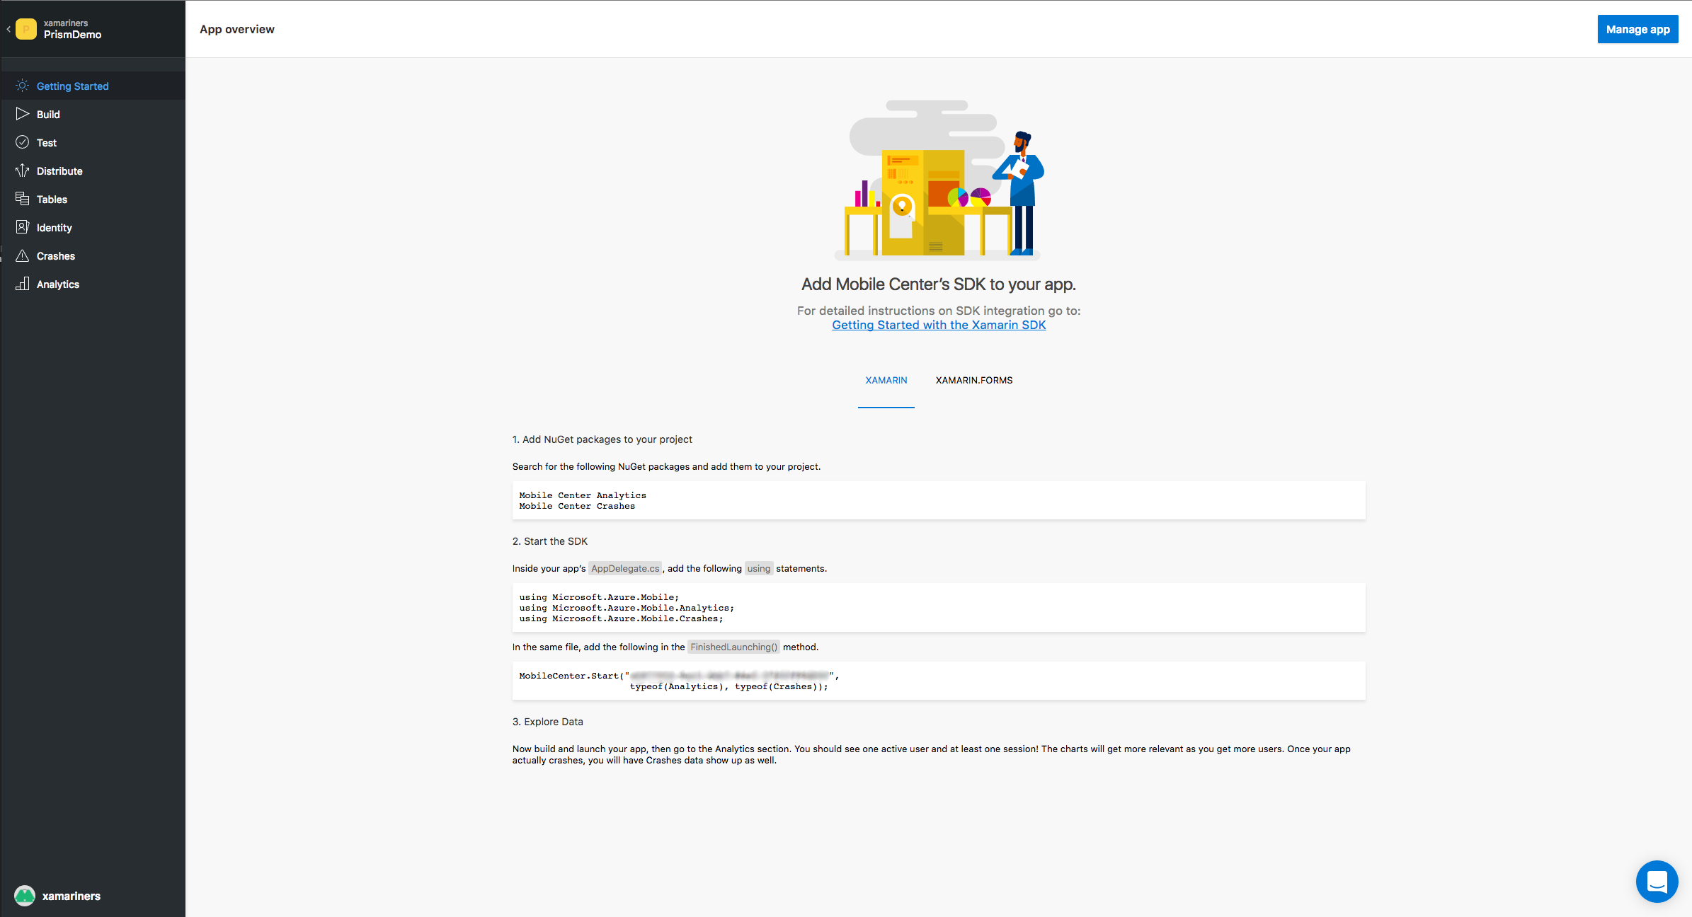
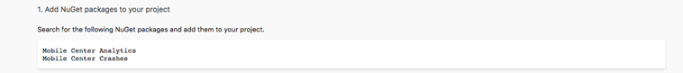
App Dashboard

Slide 15
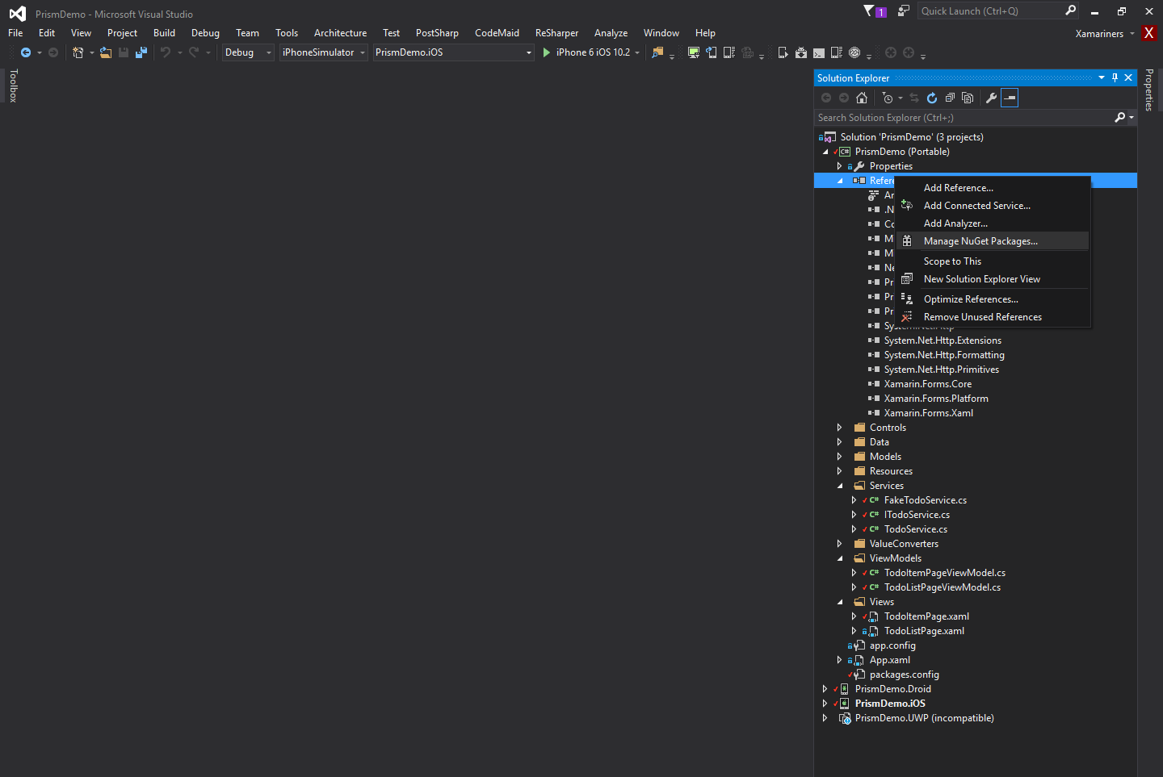
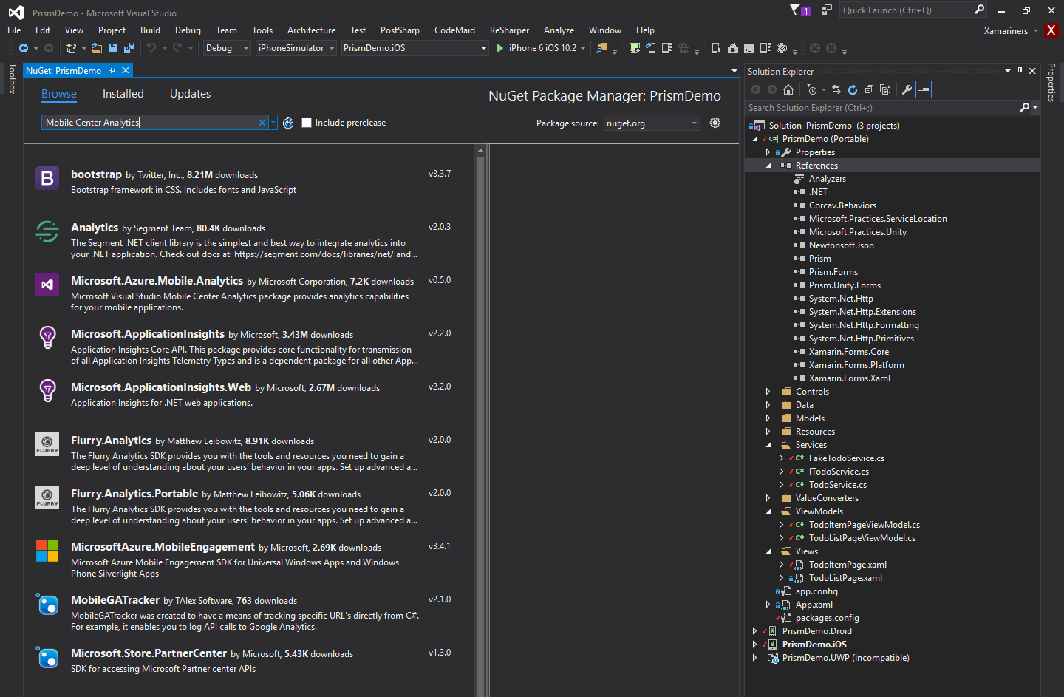
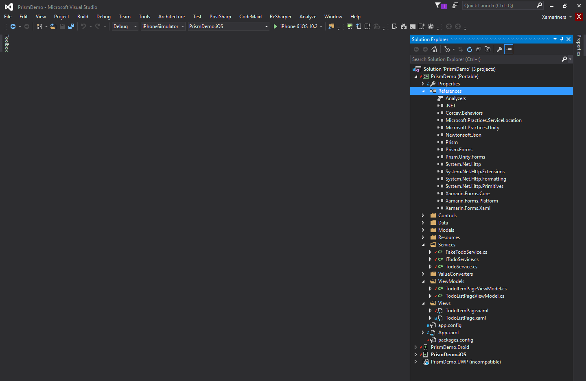
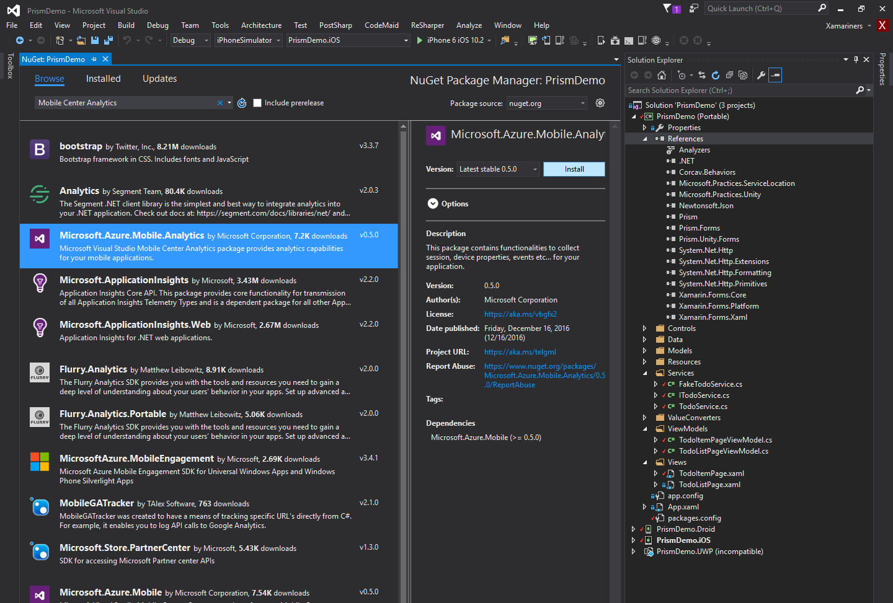
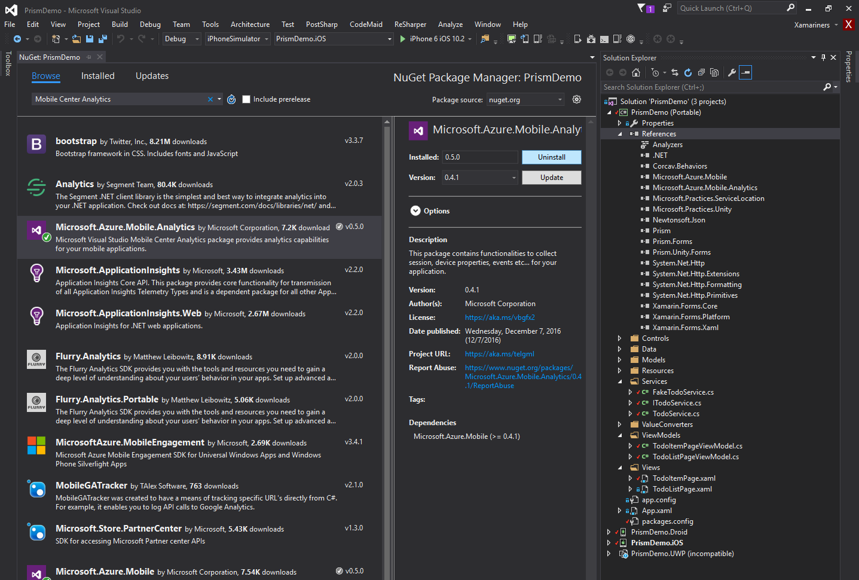
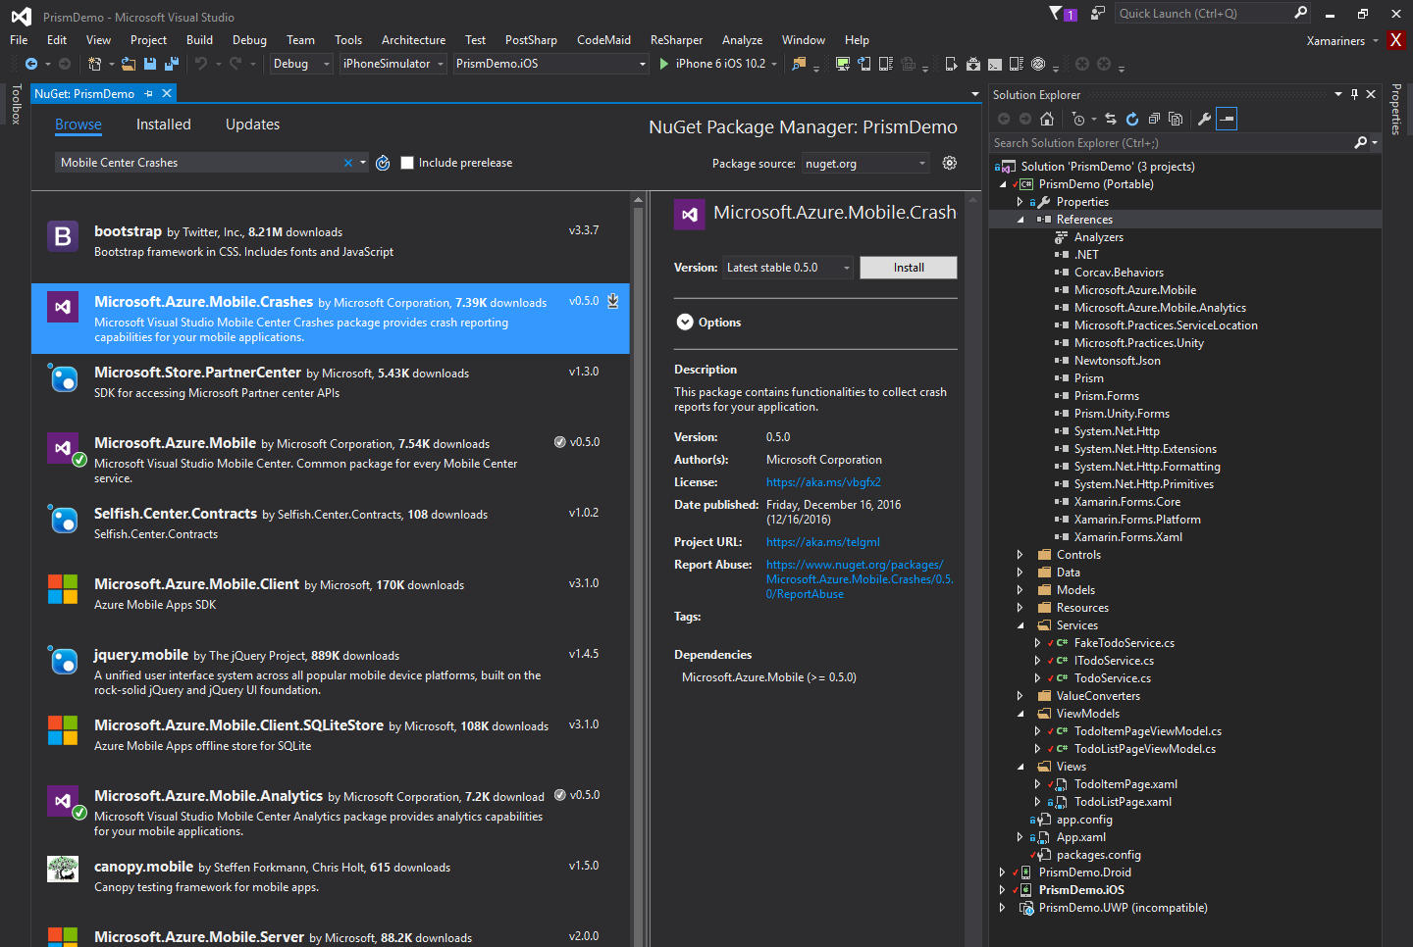
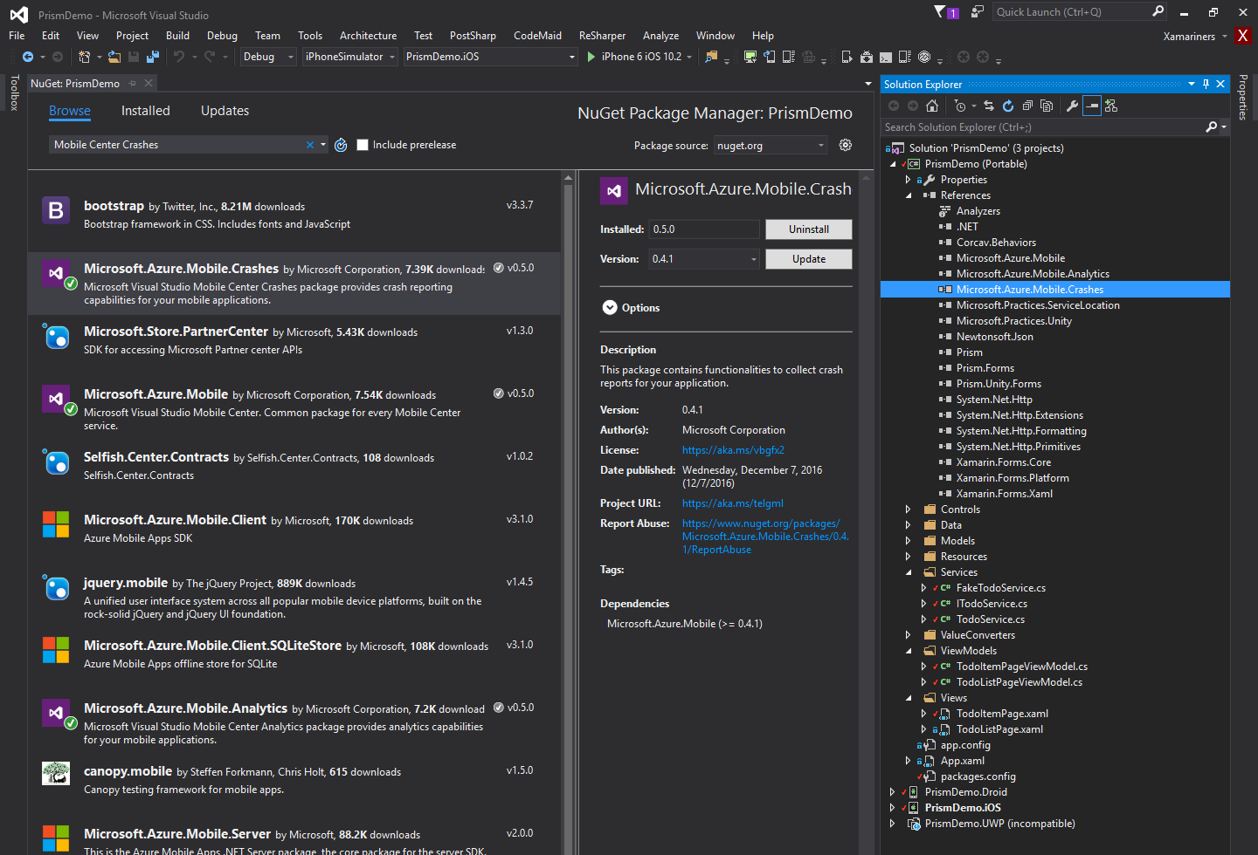
Install Packages

Slide 16
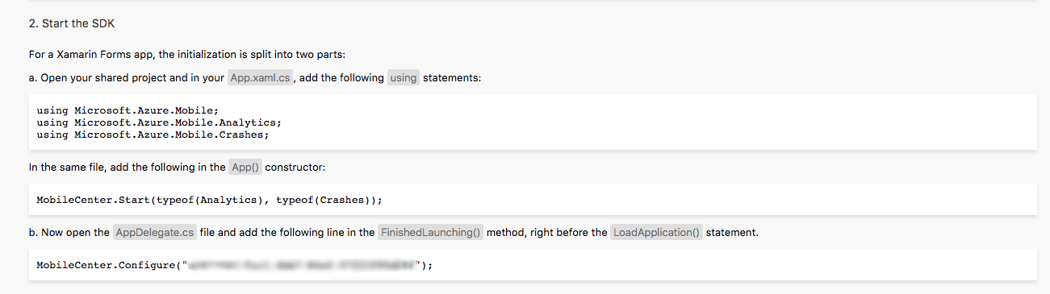
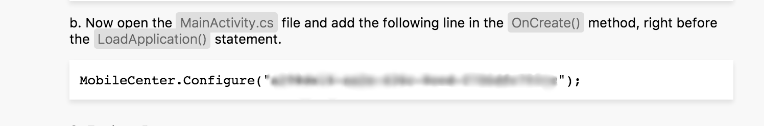


App Dashboard

Slide 17
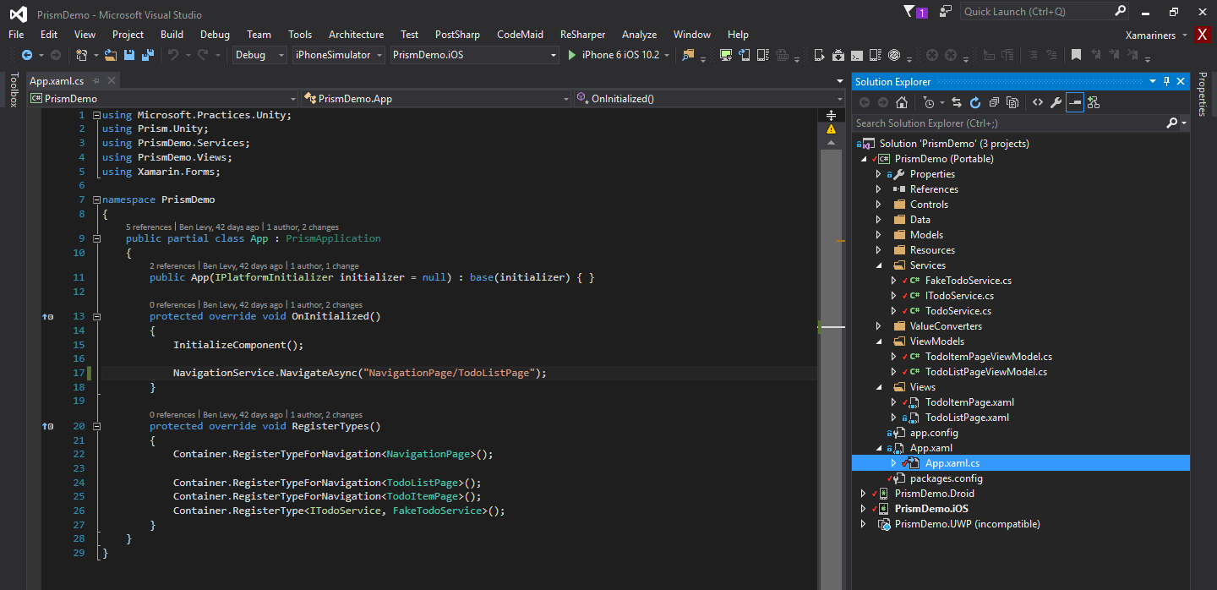
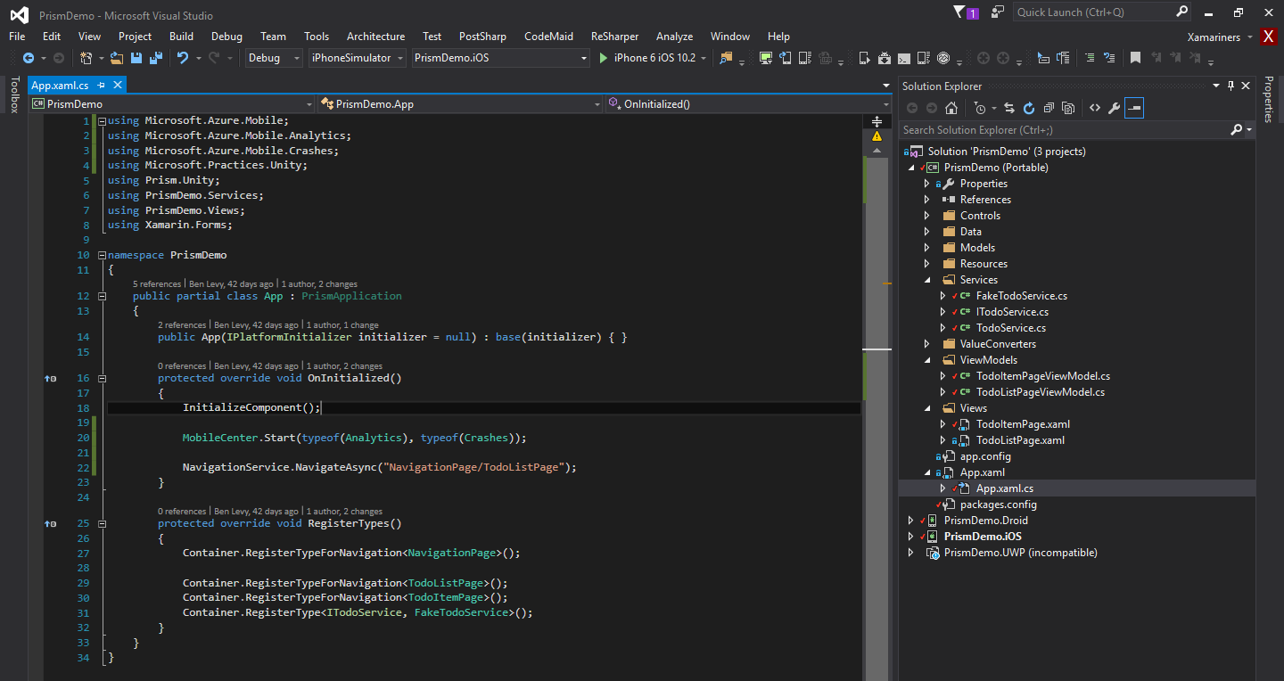
Start SDK

Slide 18
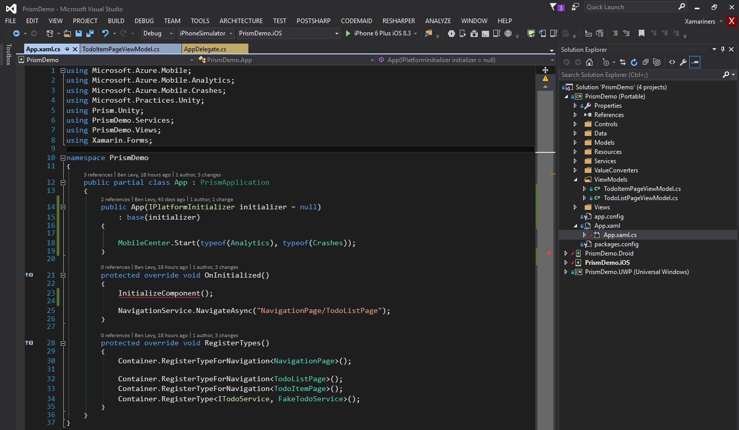
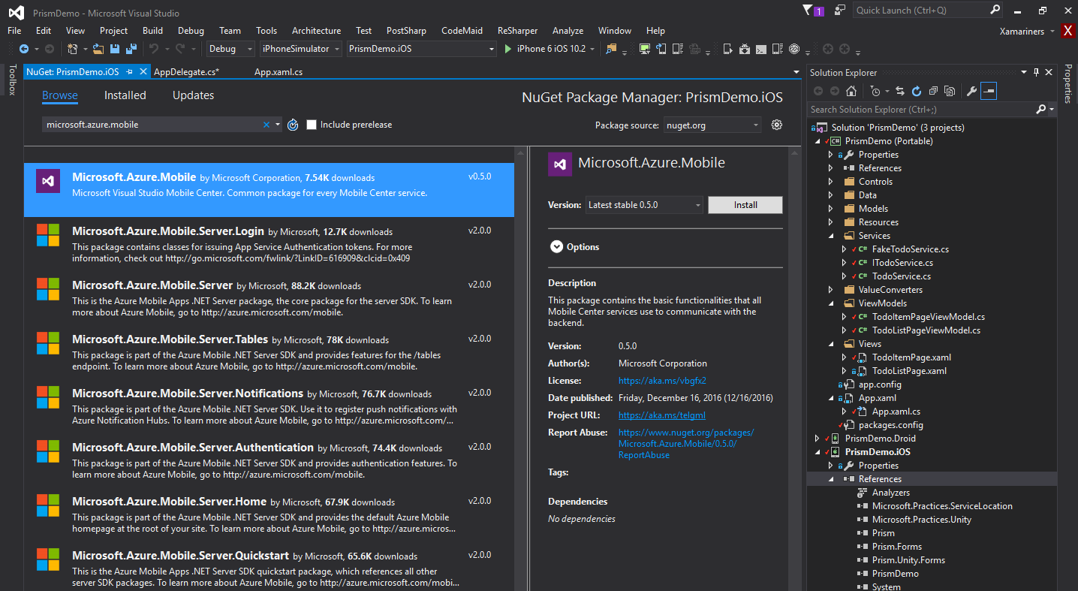
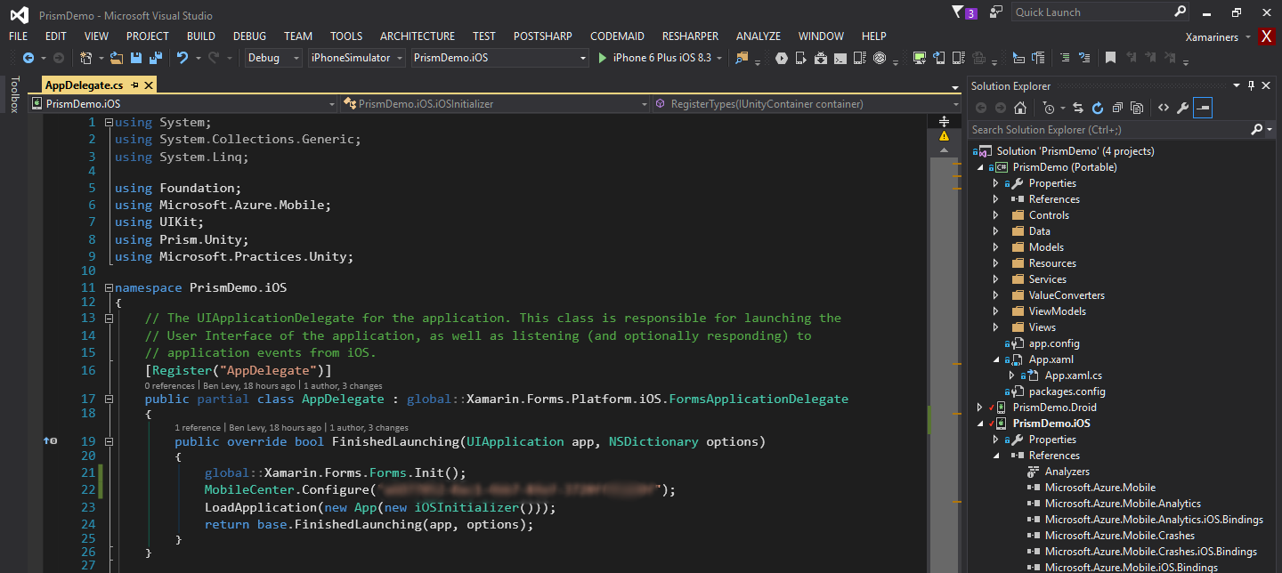
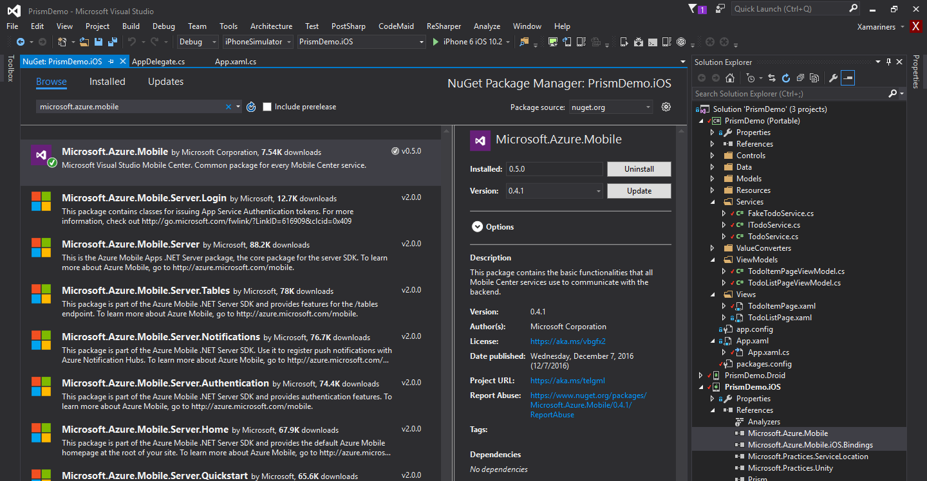
Start SDK

Slide 19
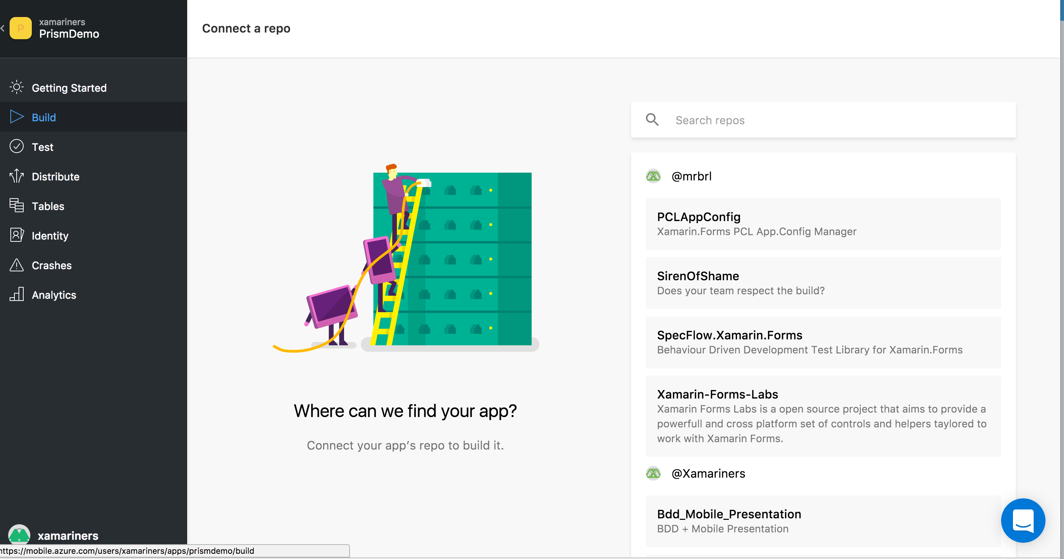
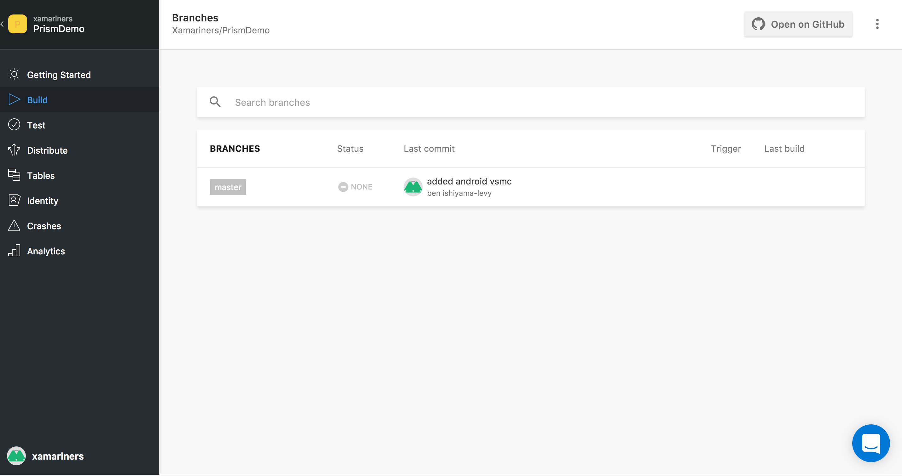
Connect to repo
Dec 2017: GitHub Supported. More to come

Slide 20
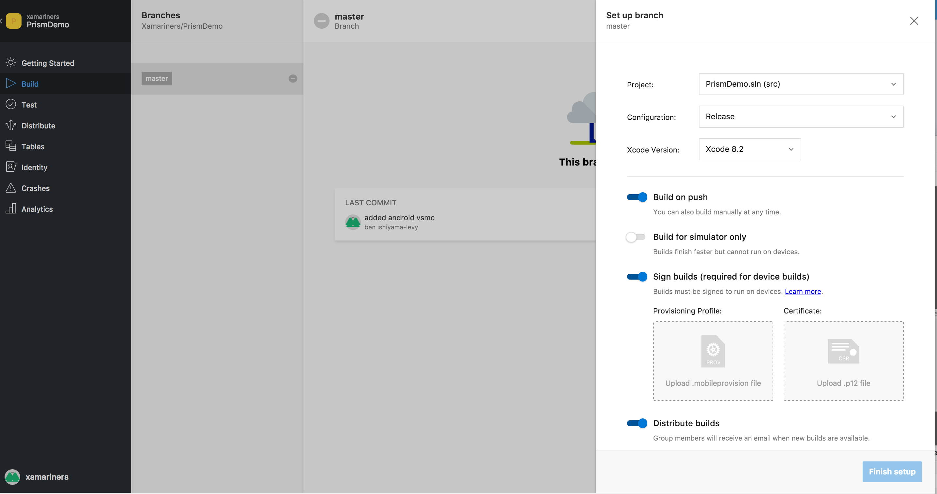
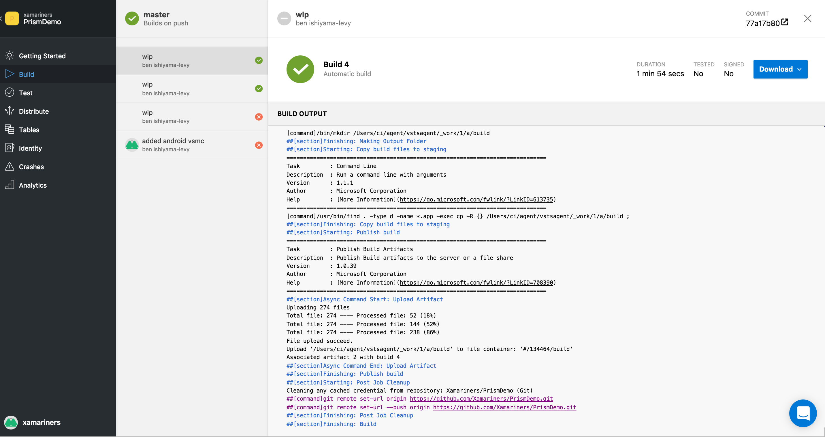
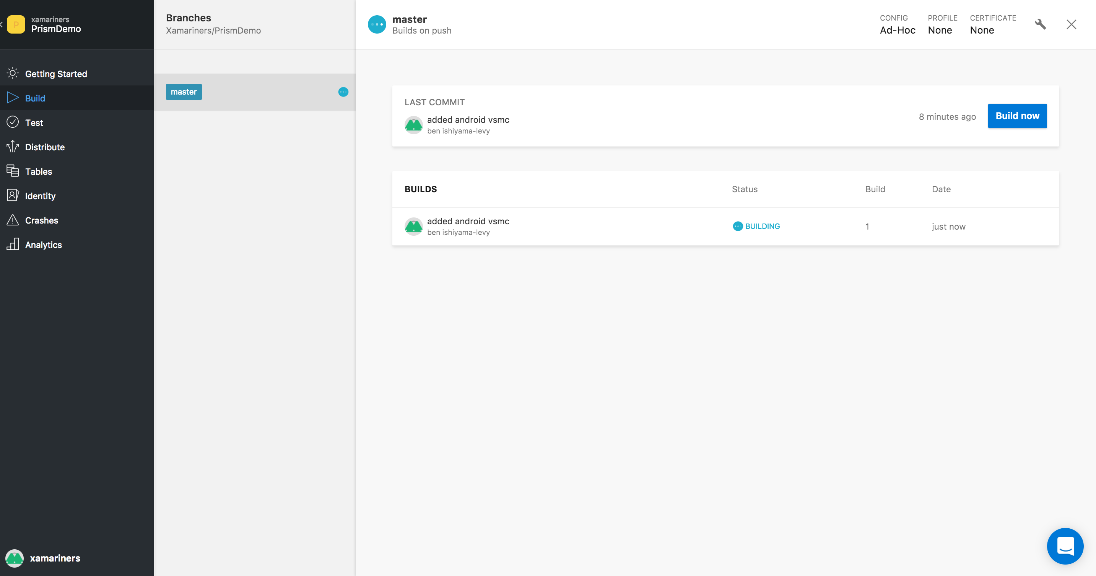
Build
iOS: no longer macOS build machine. VSMC sorts it out for you

Slide 21
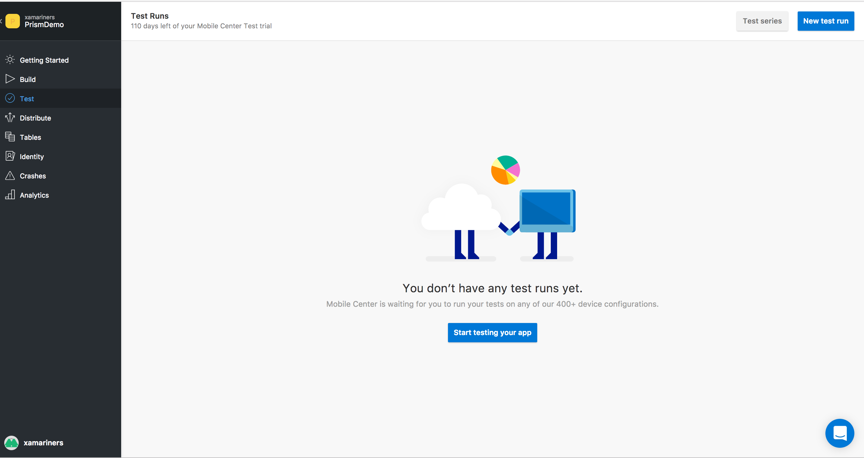
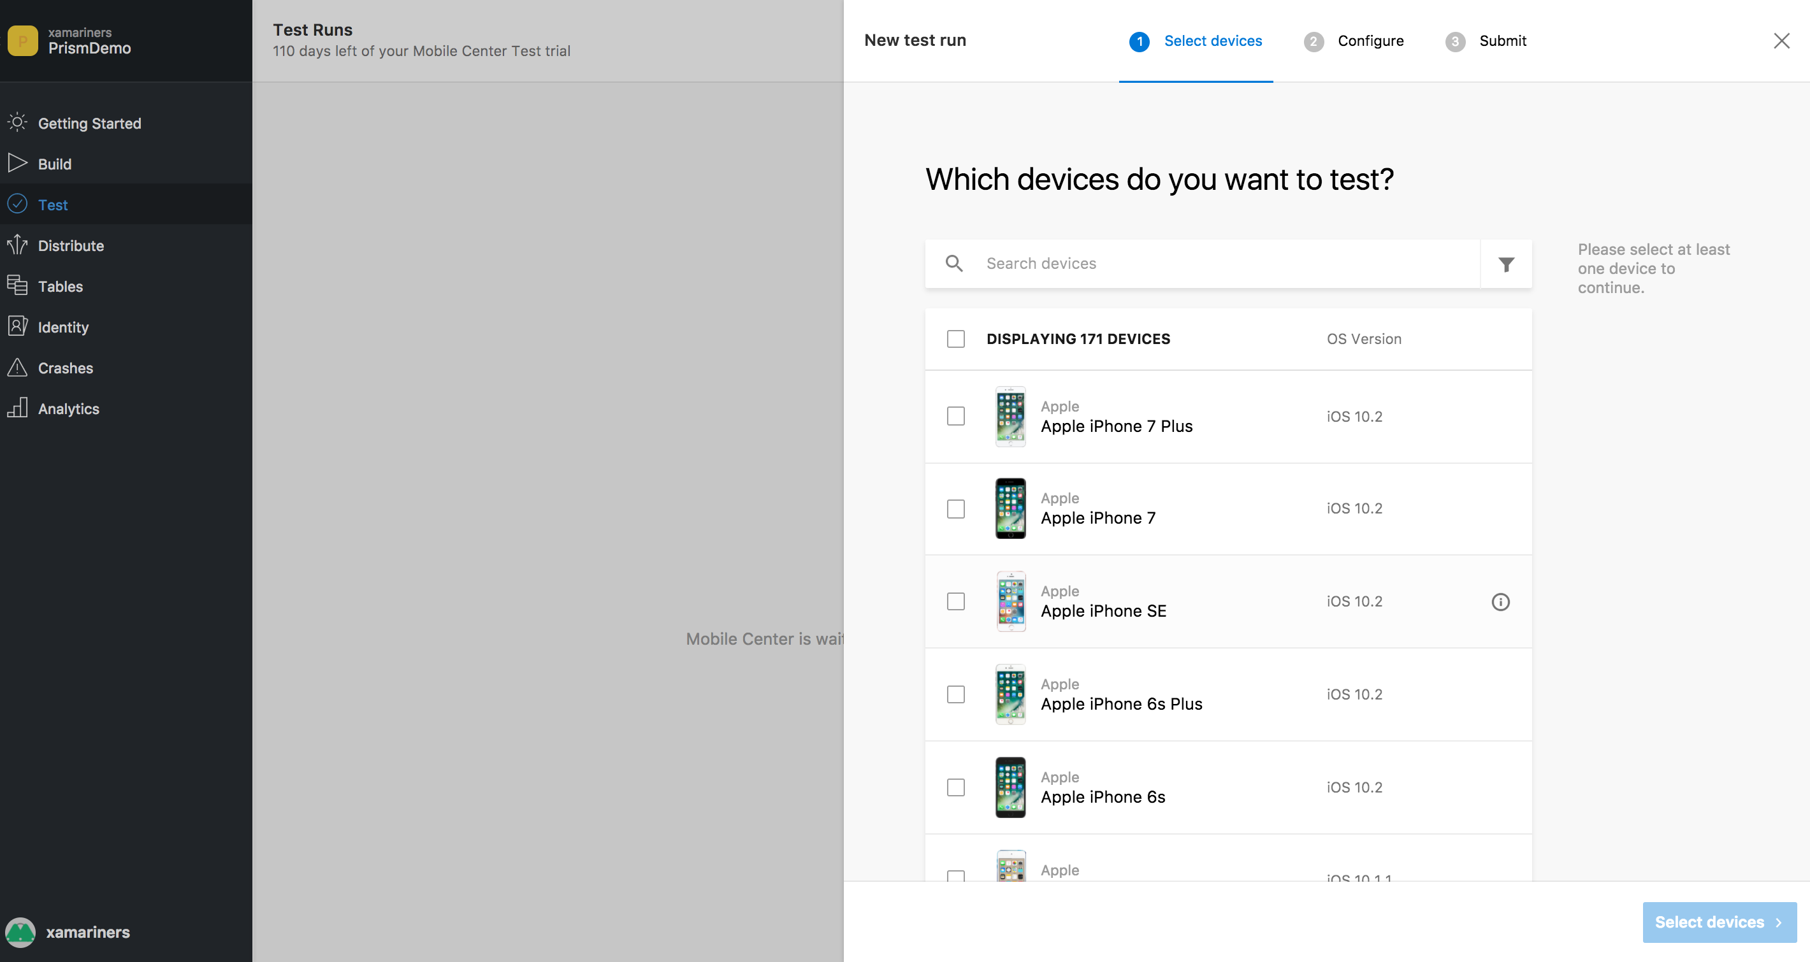
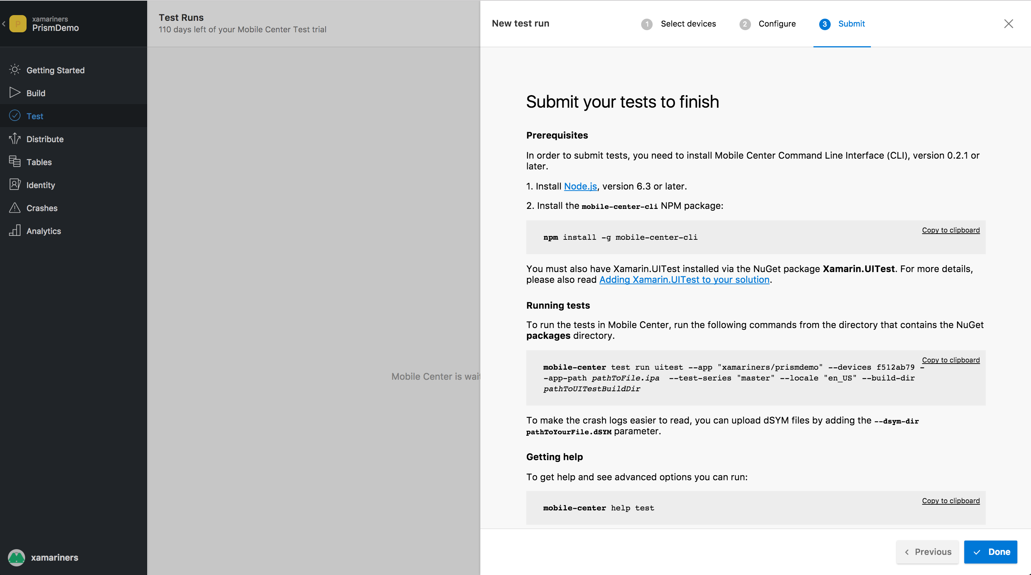
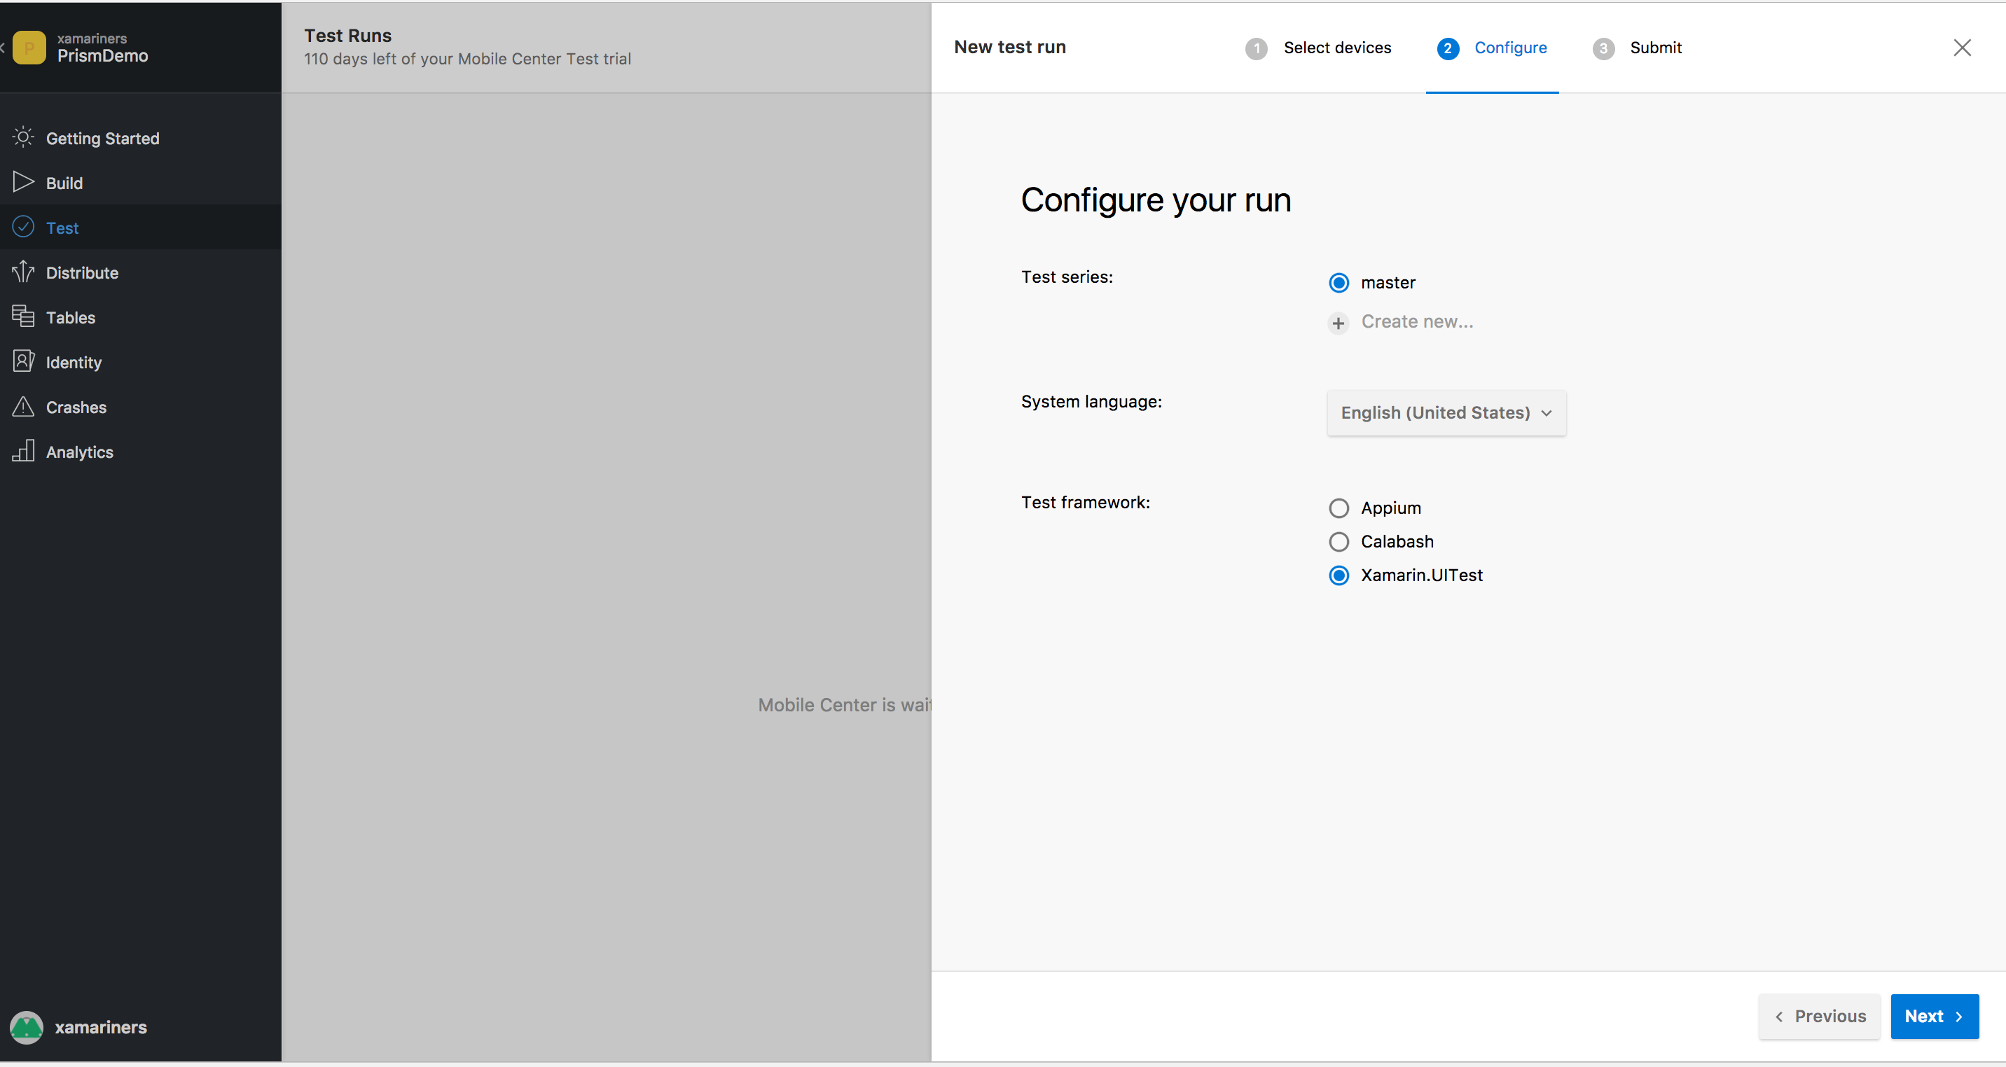
Test Setup

Slide 22
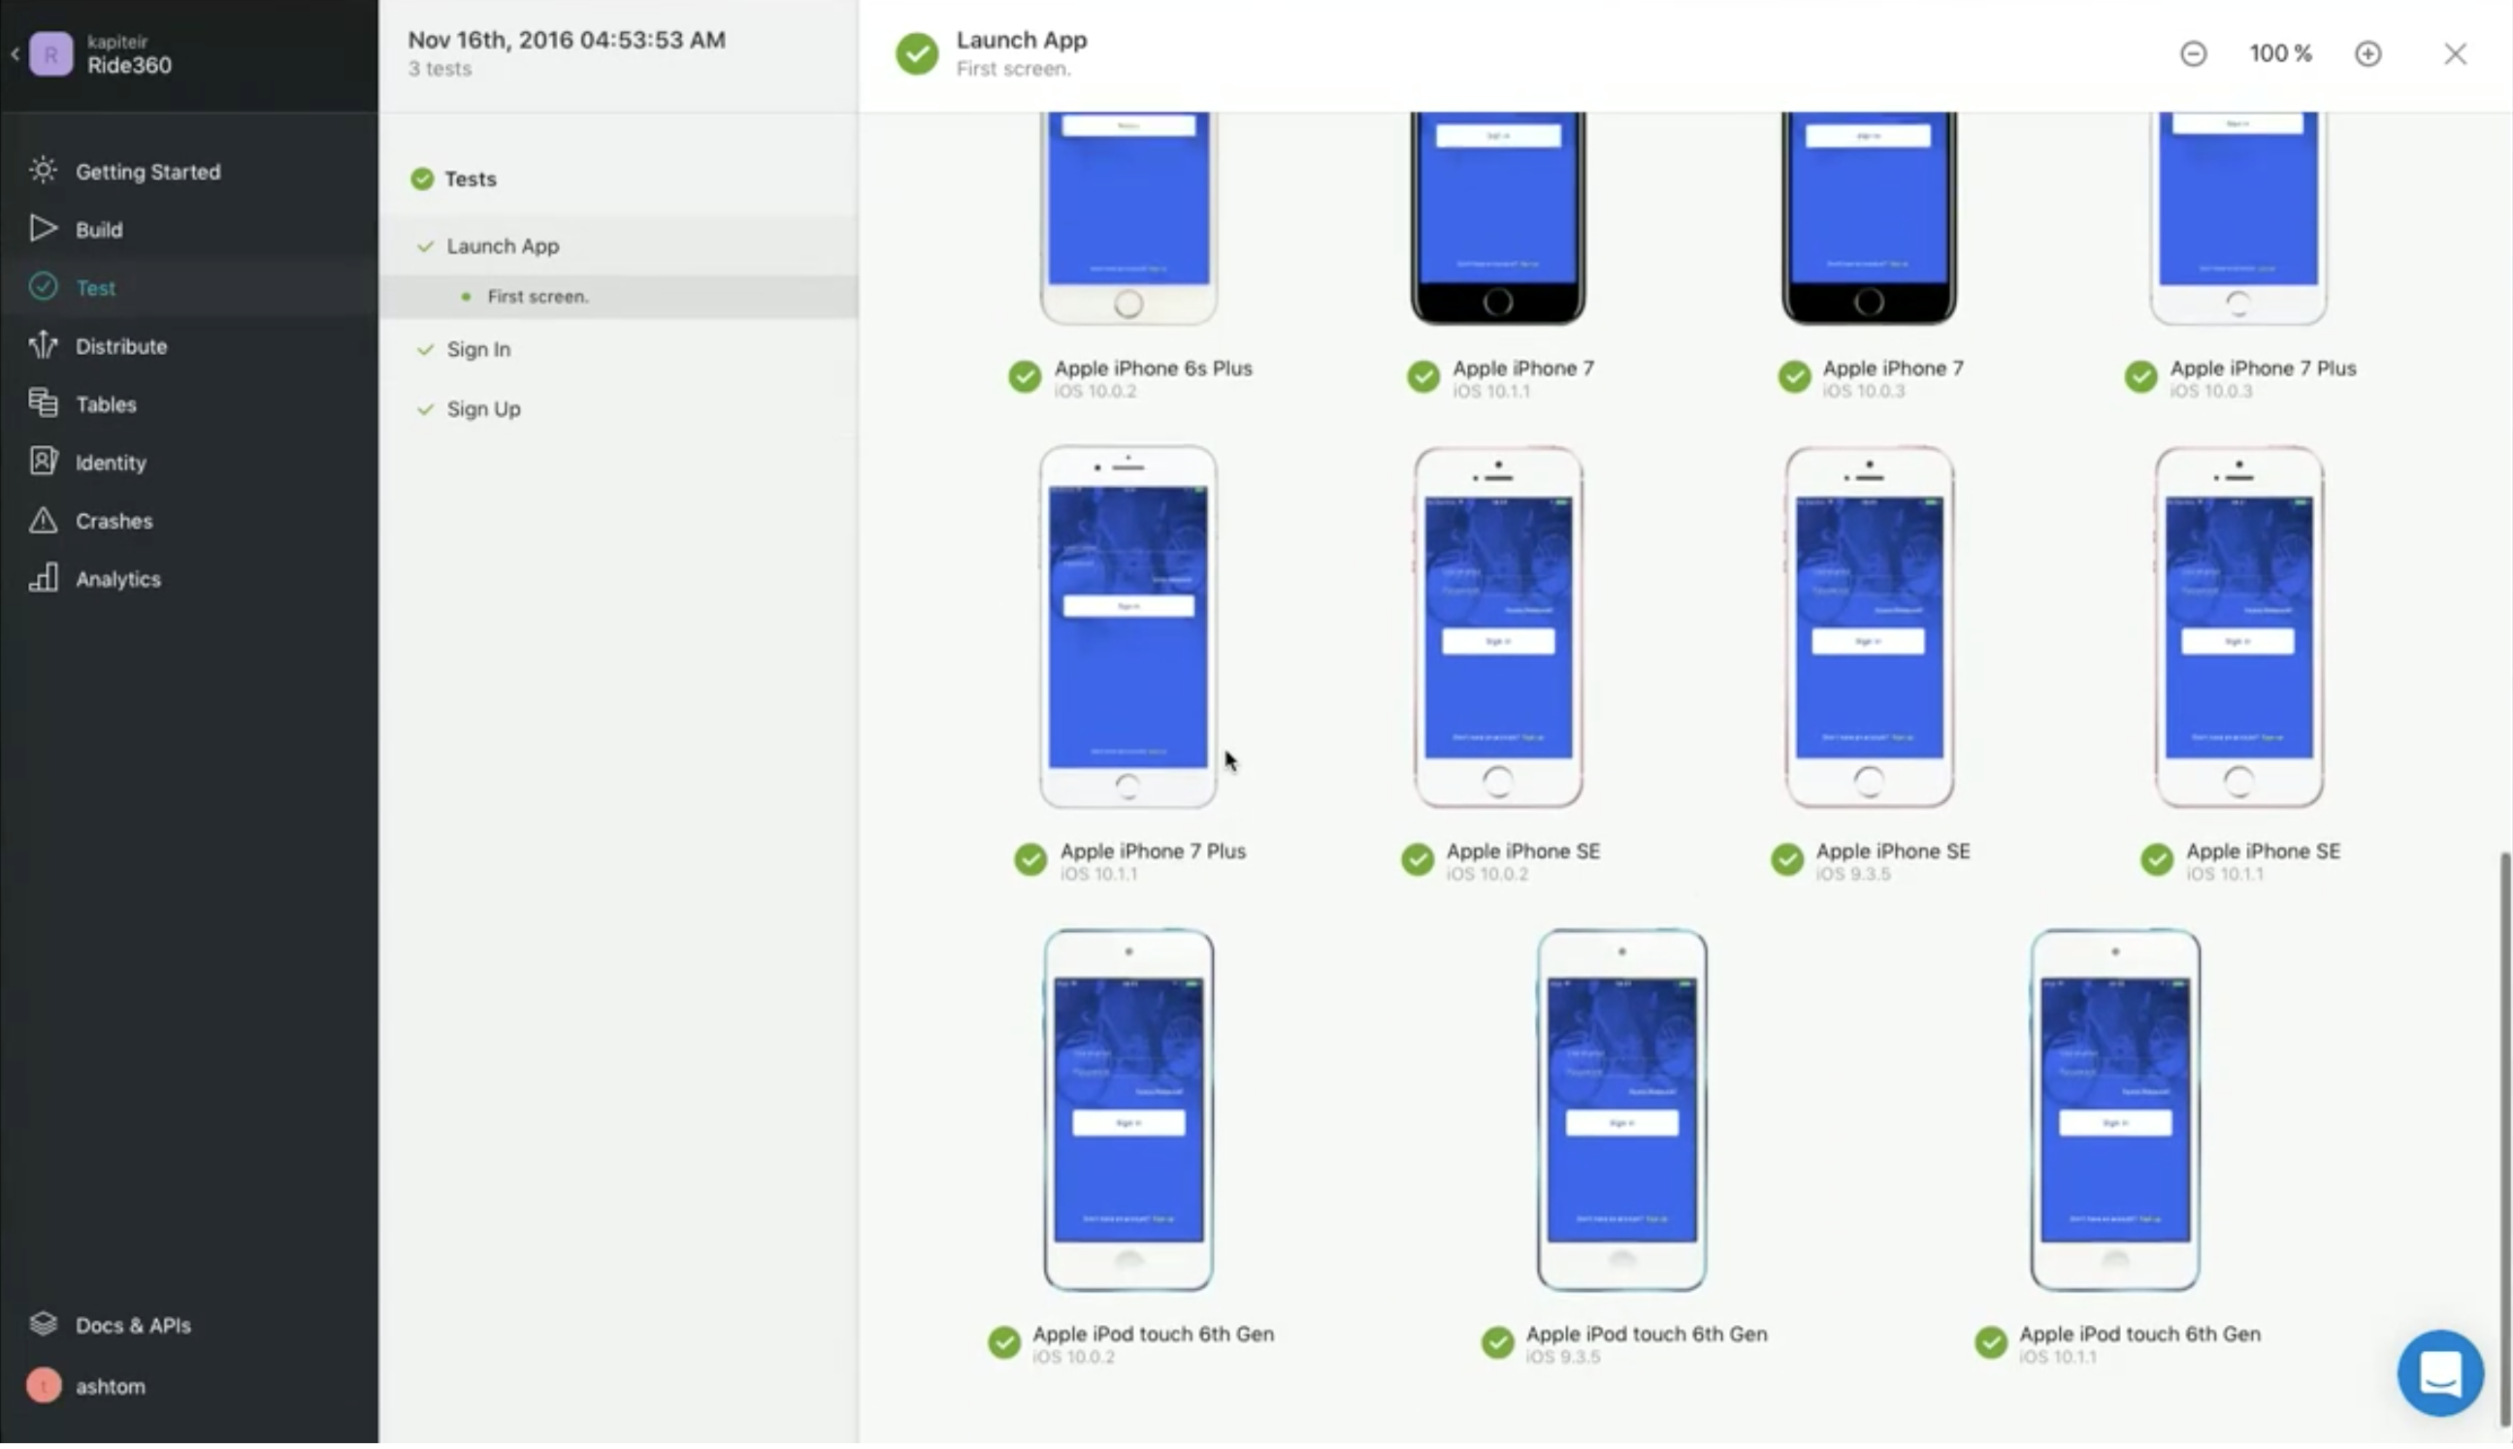
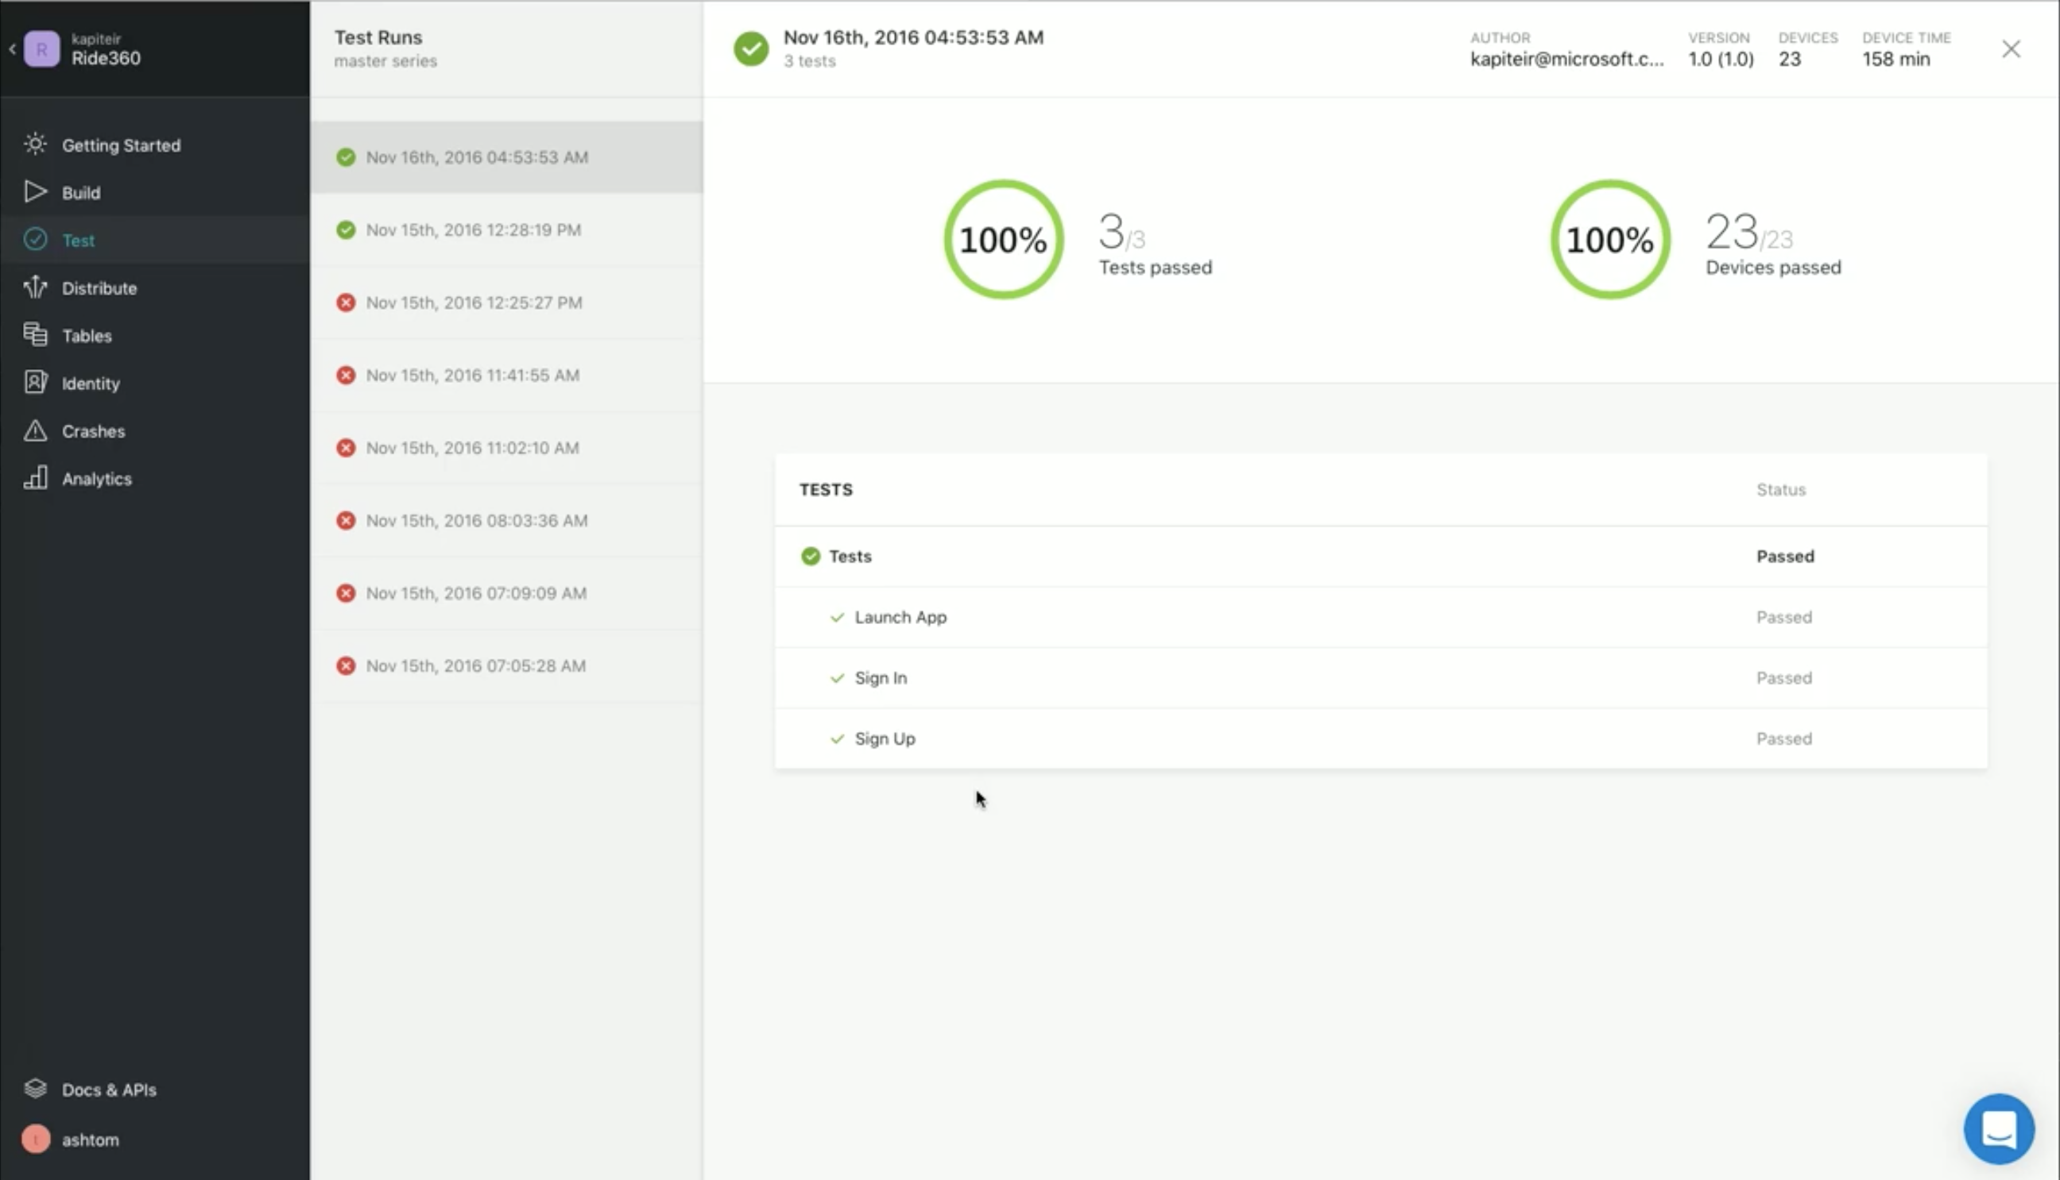
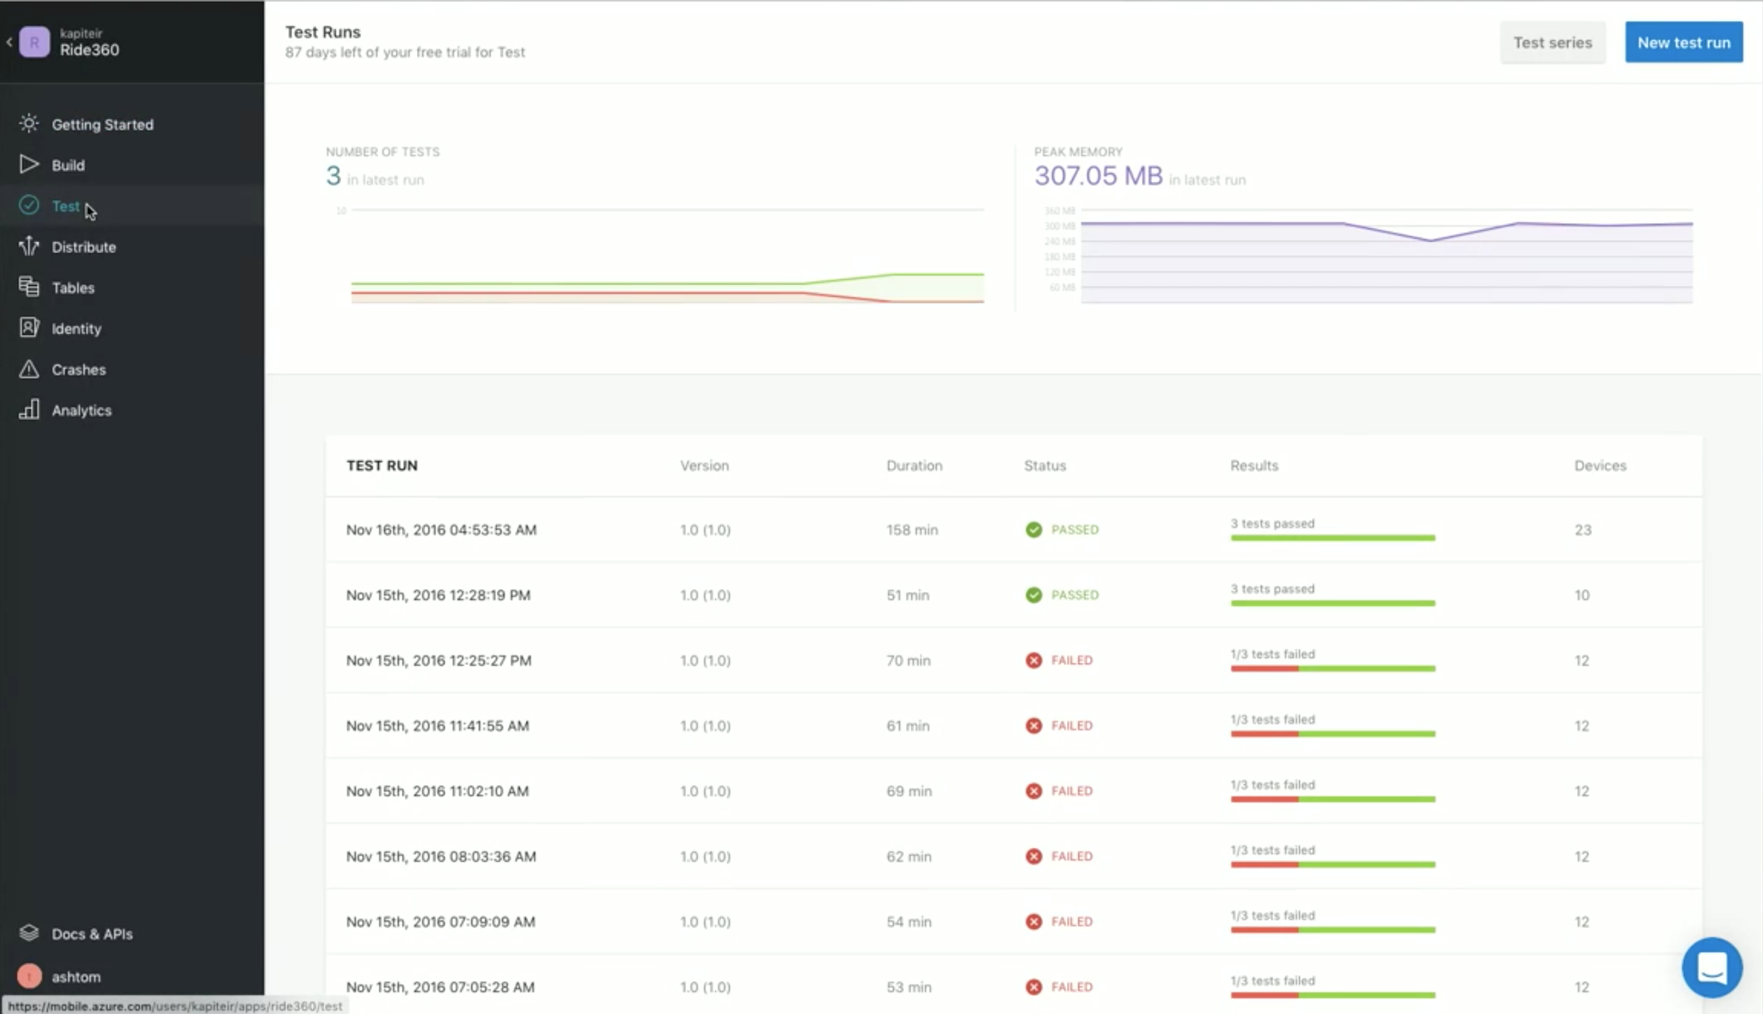
Test Results

Slide 23
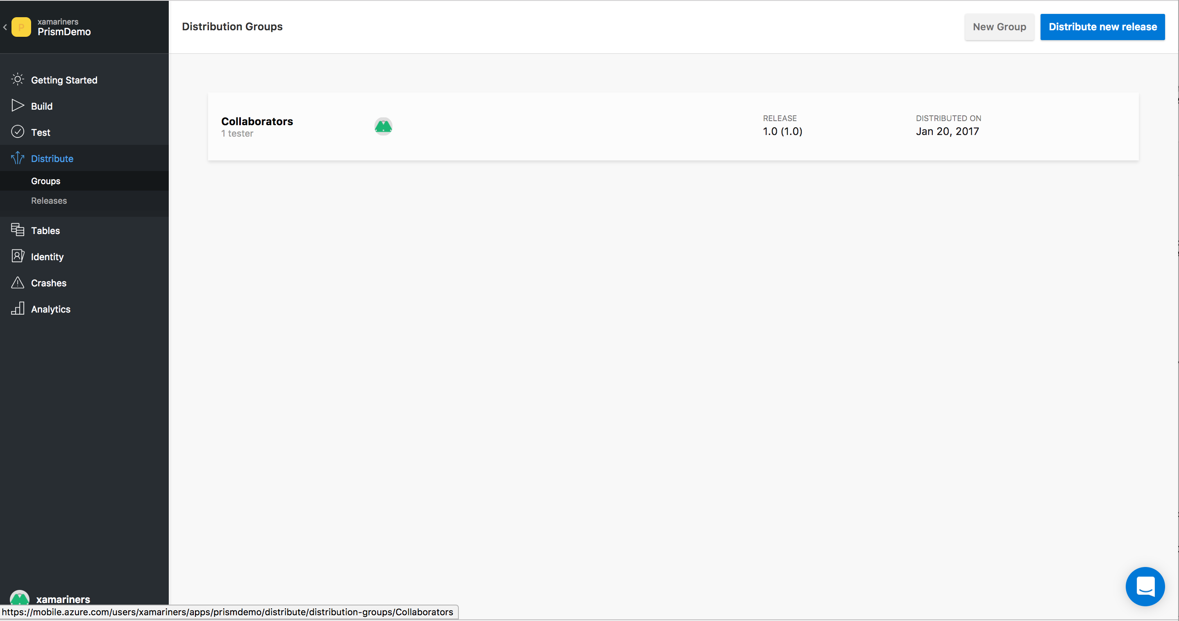
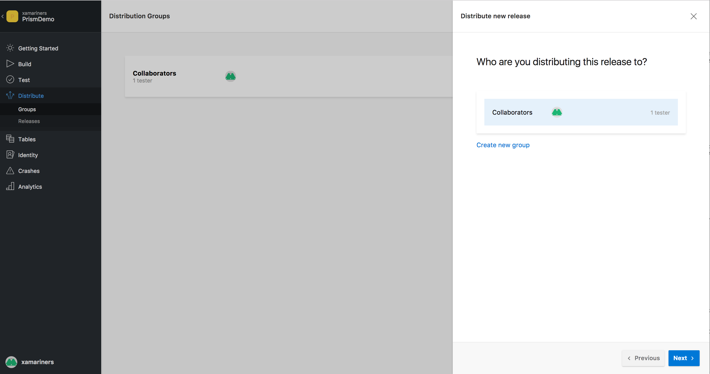
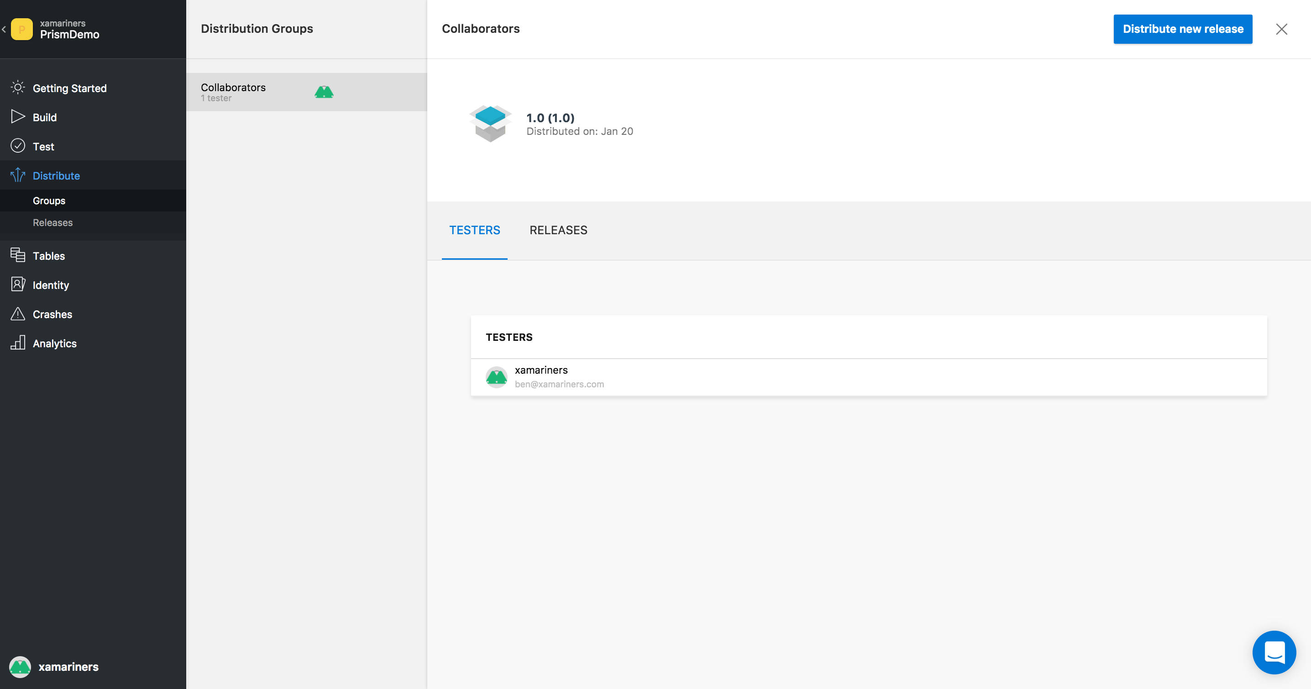
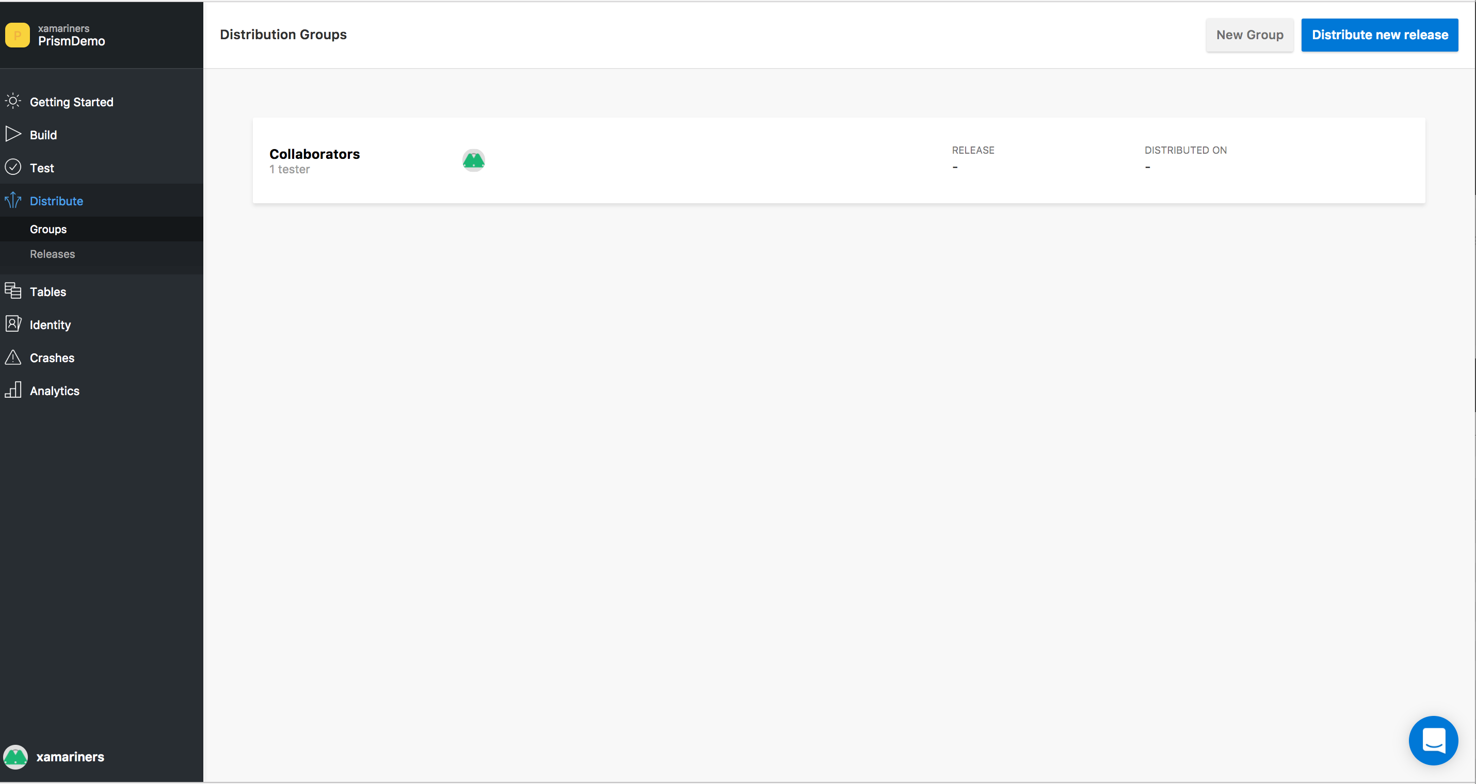
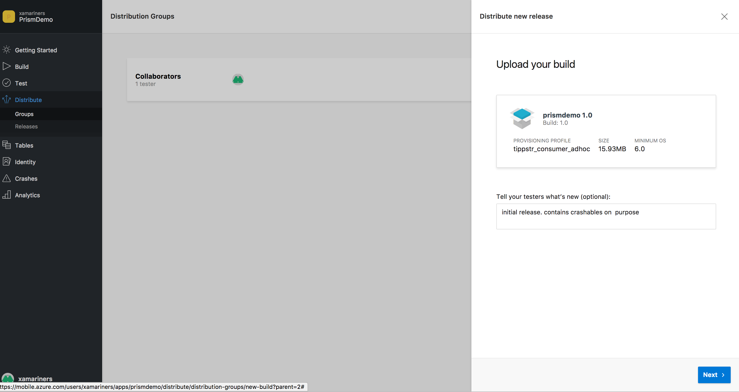
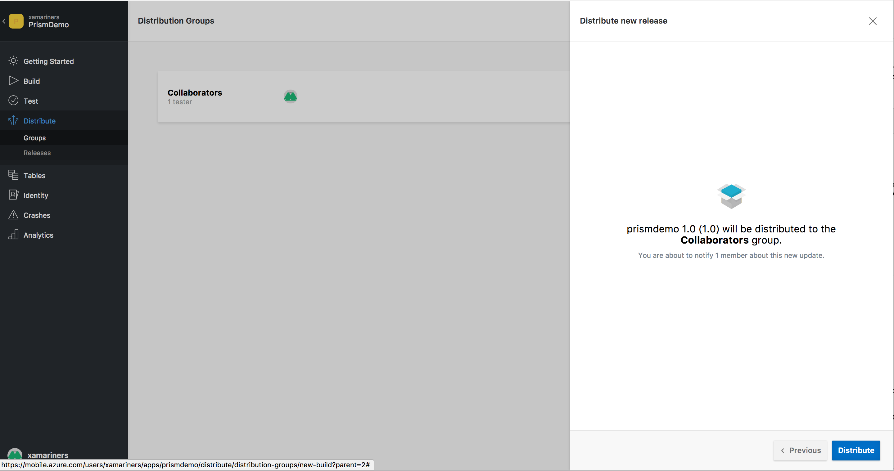
Distribute

Slide 24
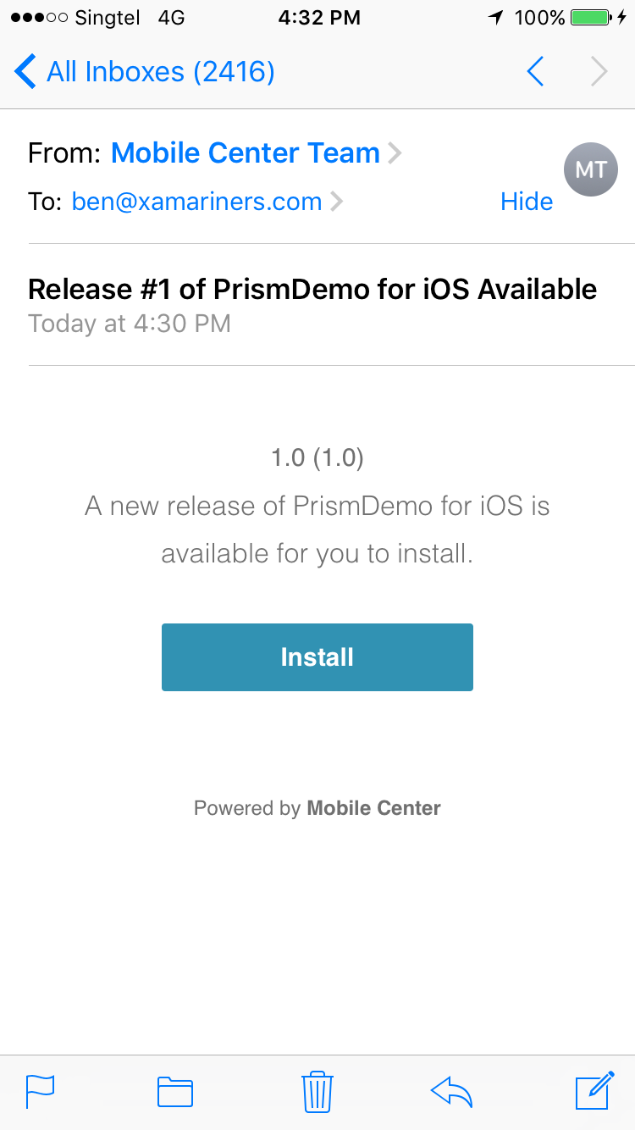
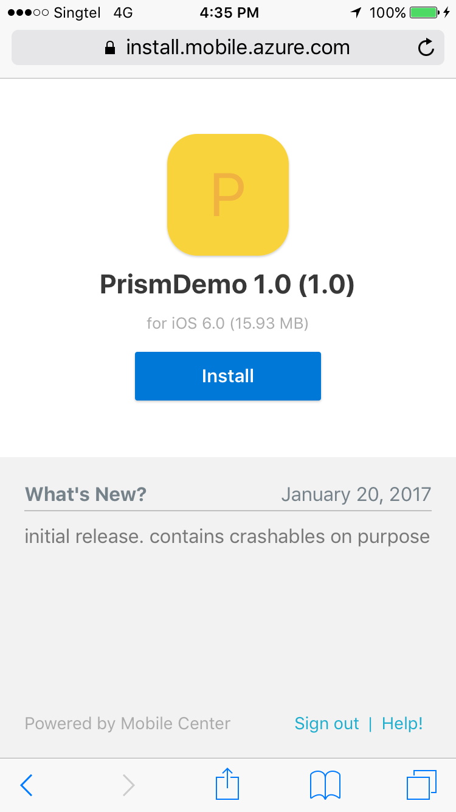
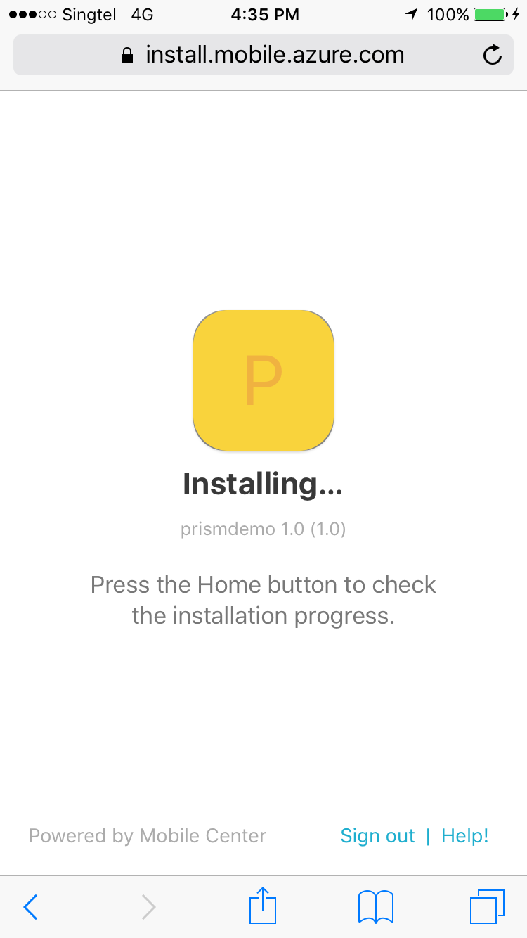
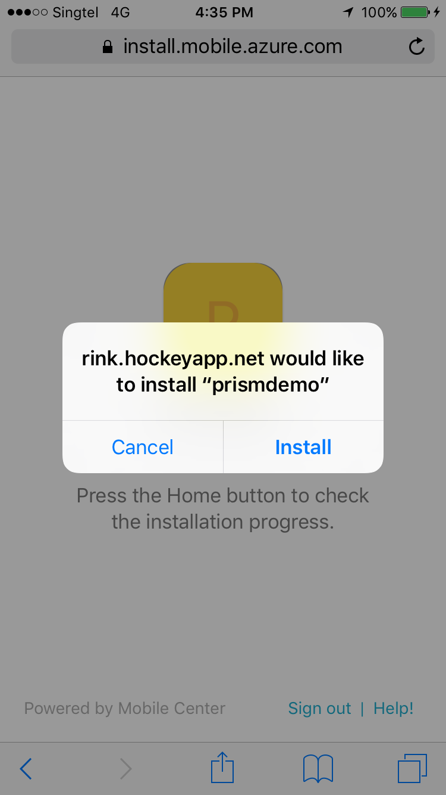
Distribute (Device)

Slide 25
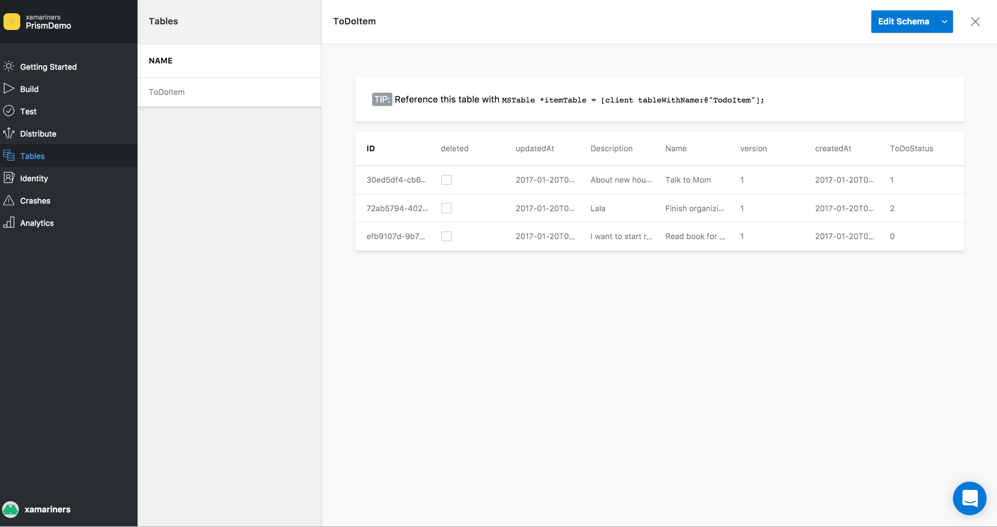
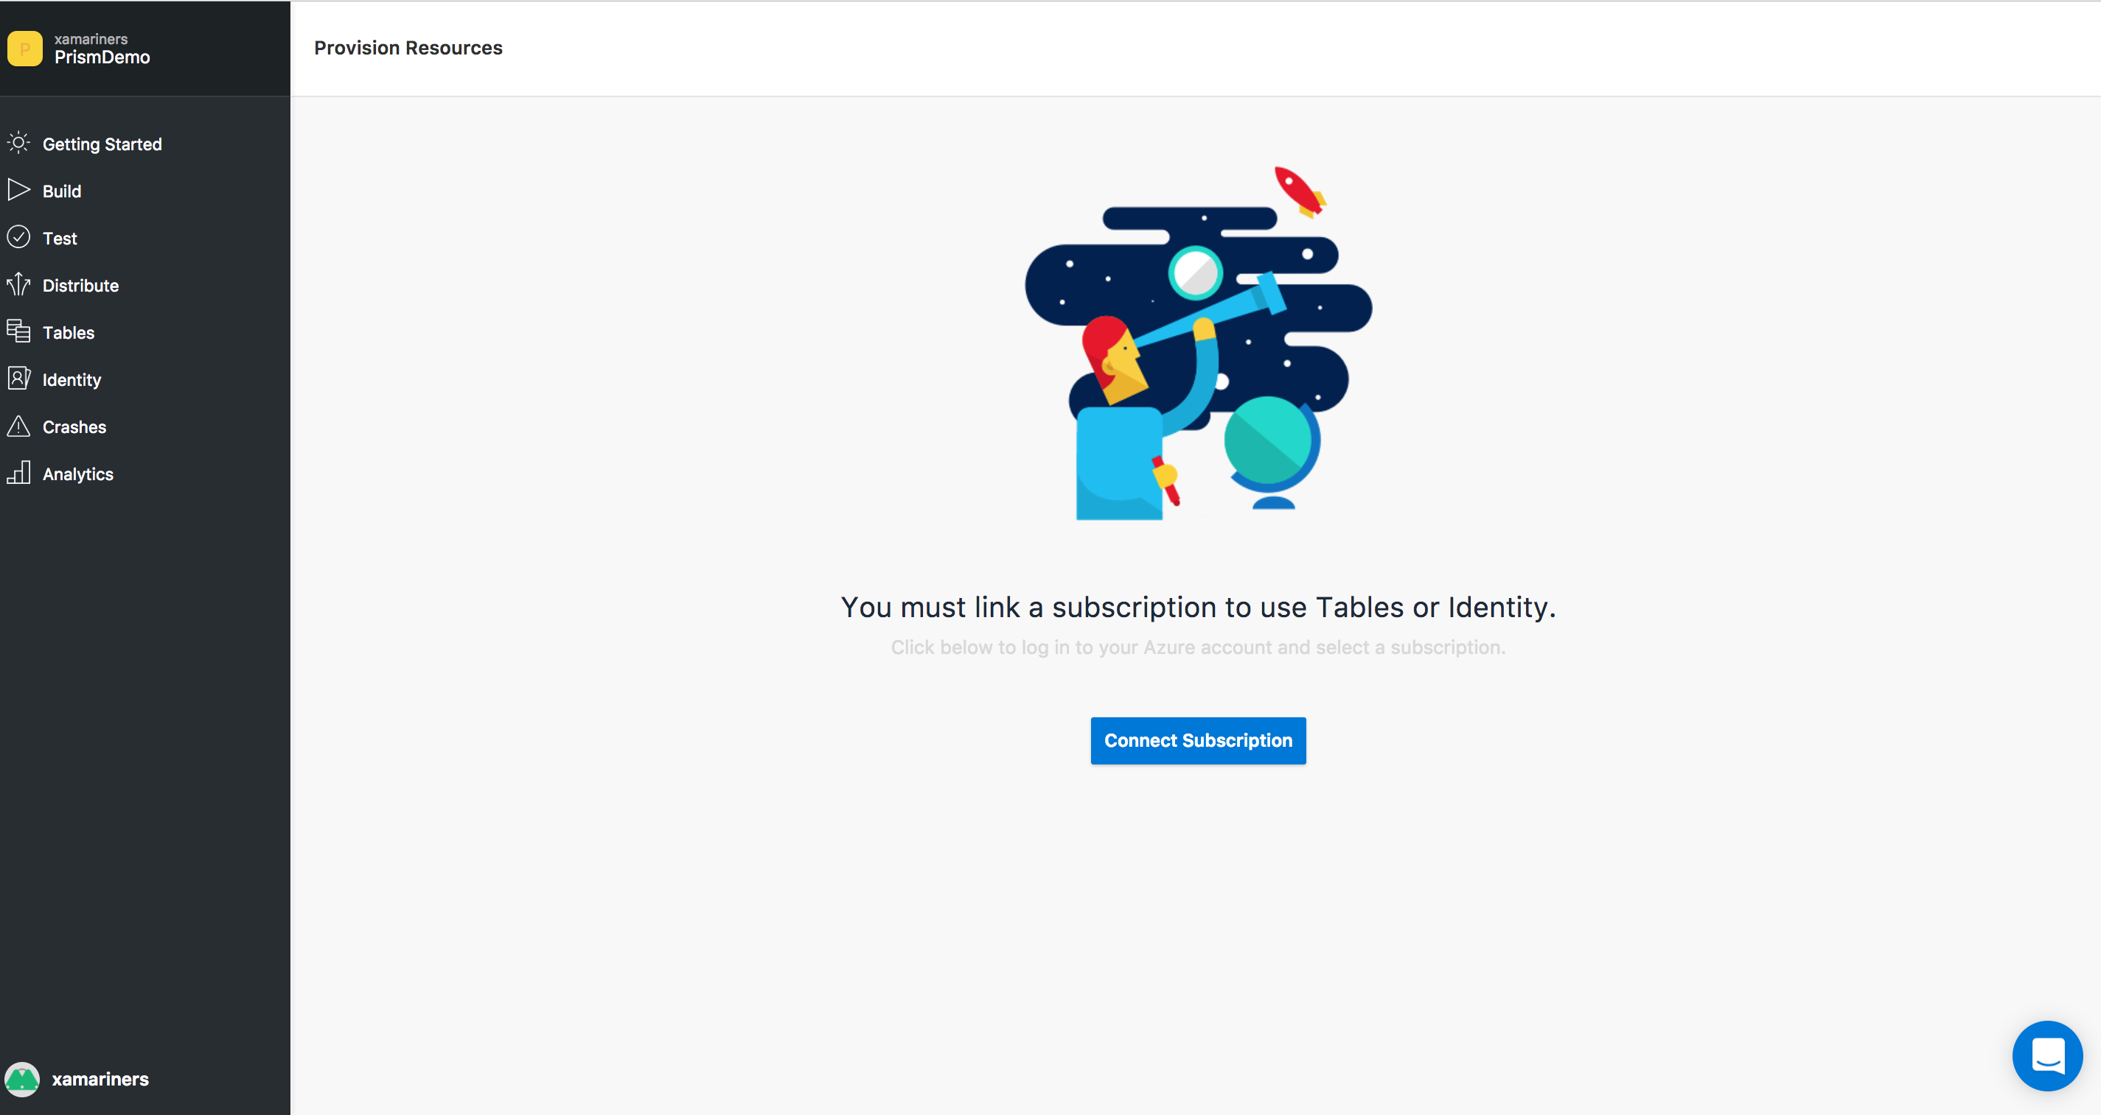
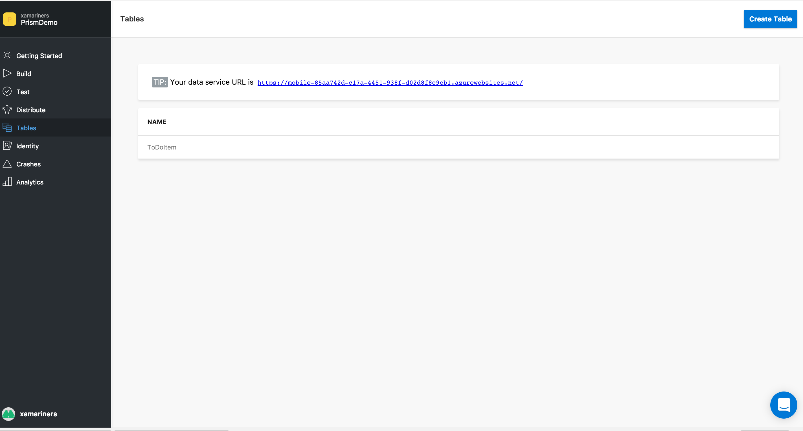
Tables

Slide 26
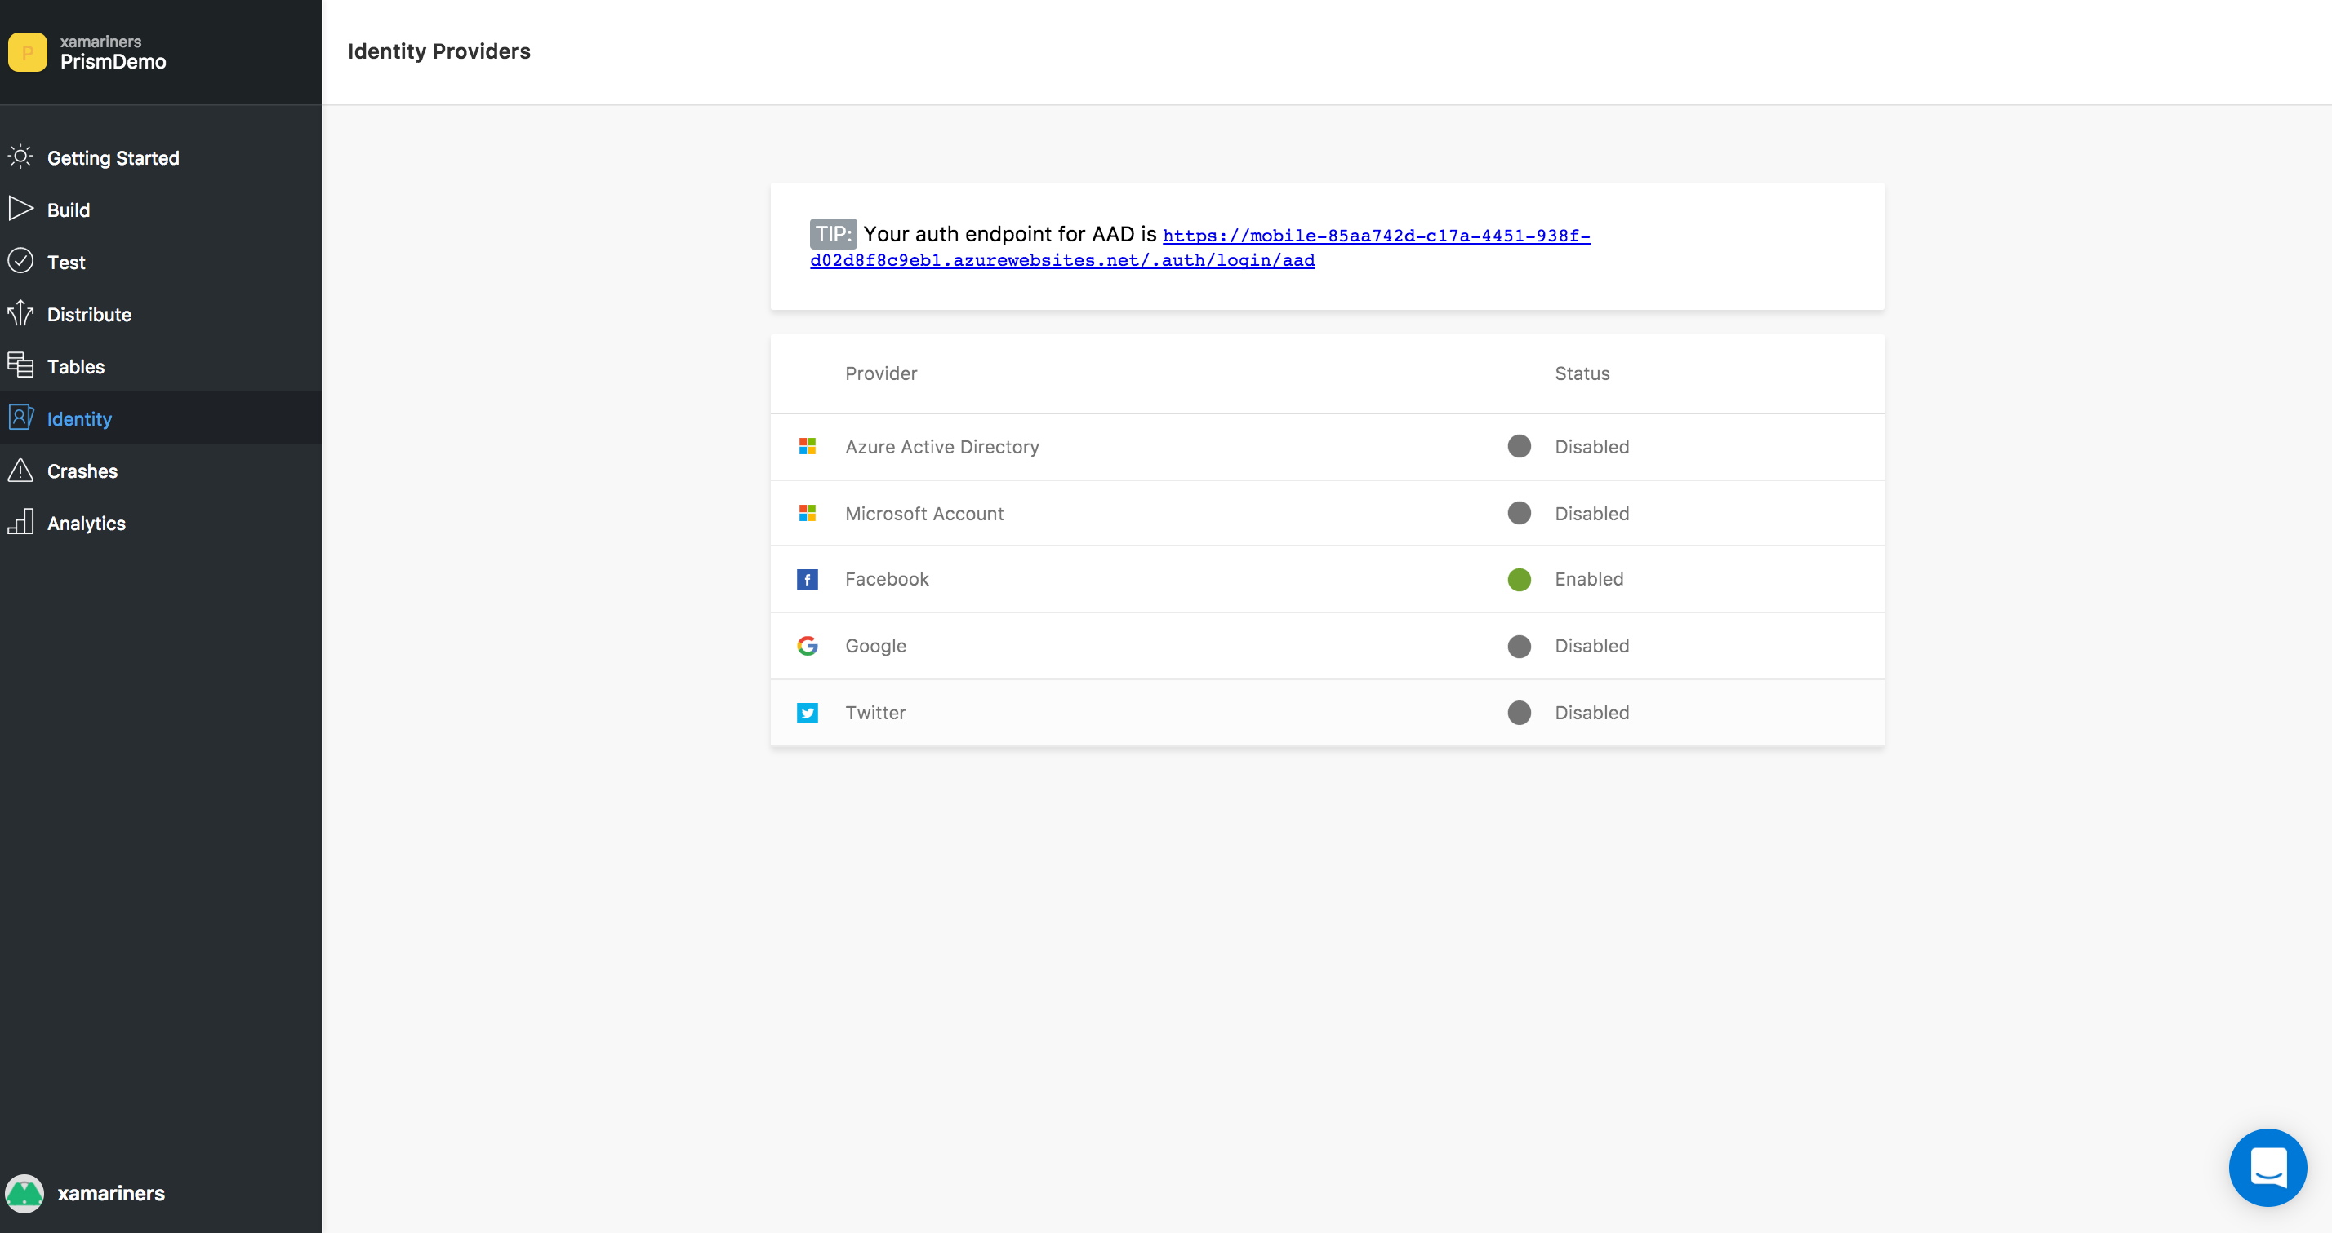
Identity

Slide 27
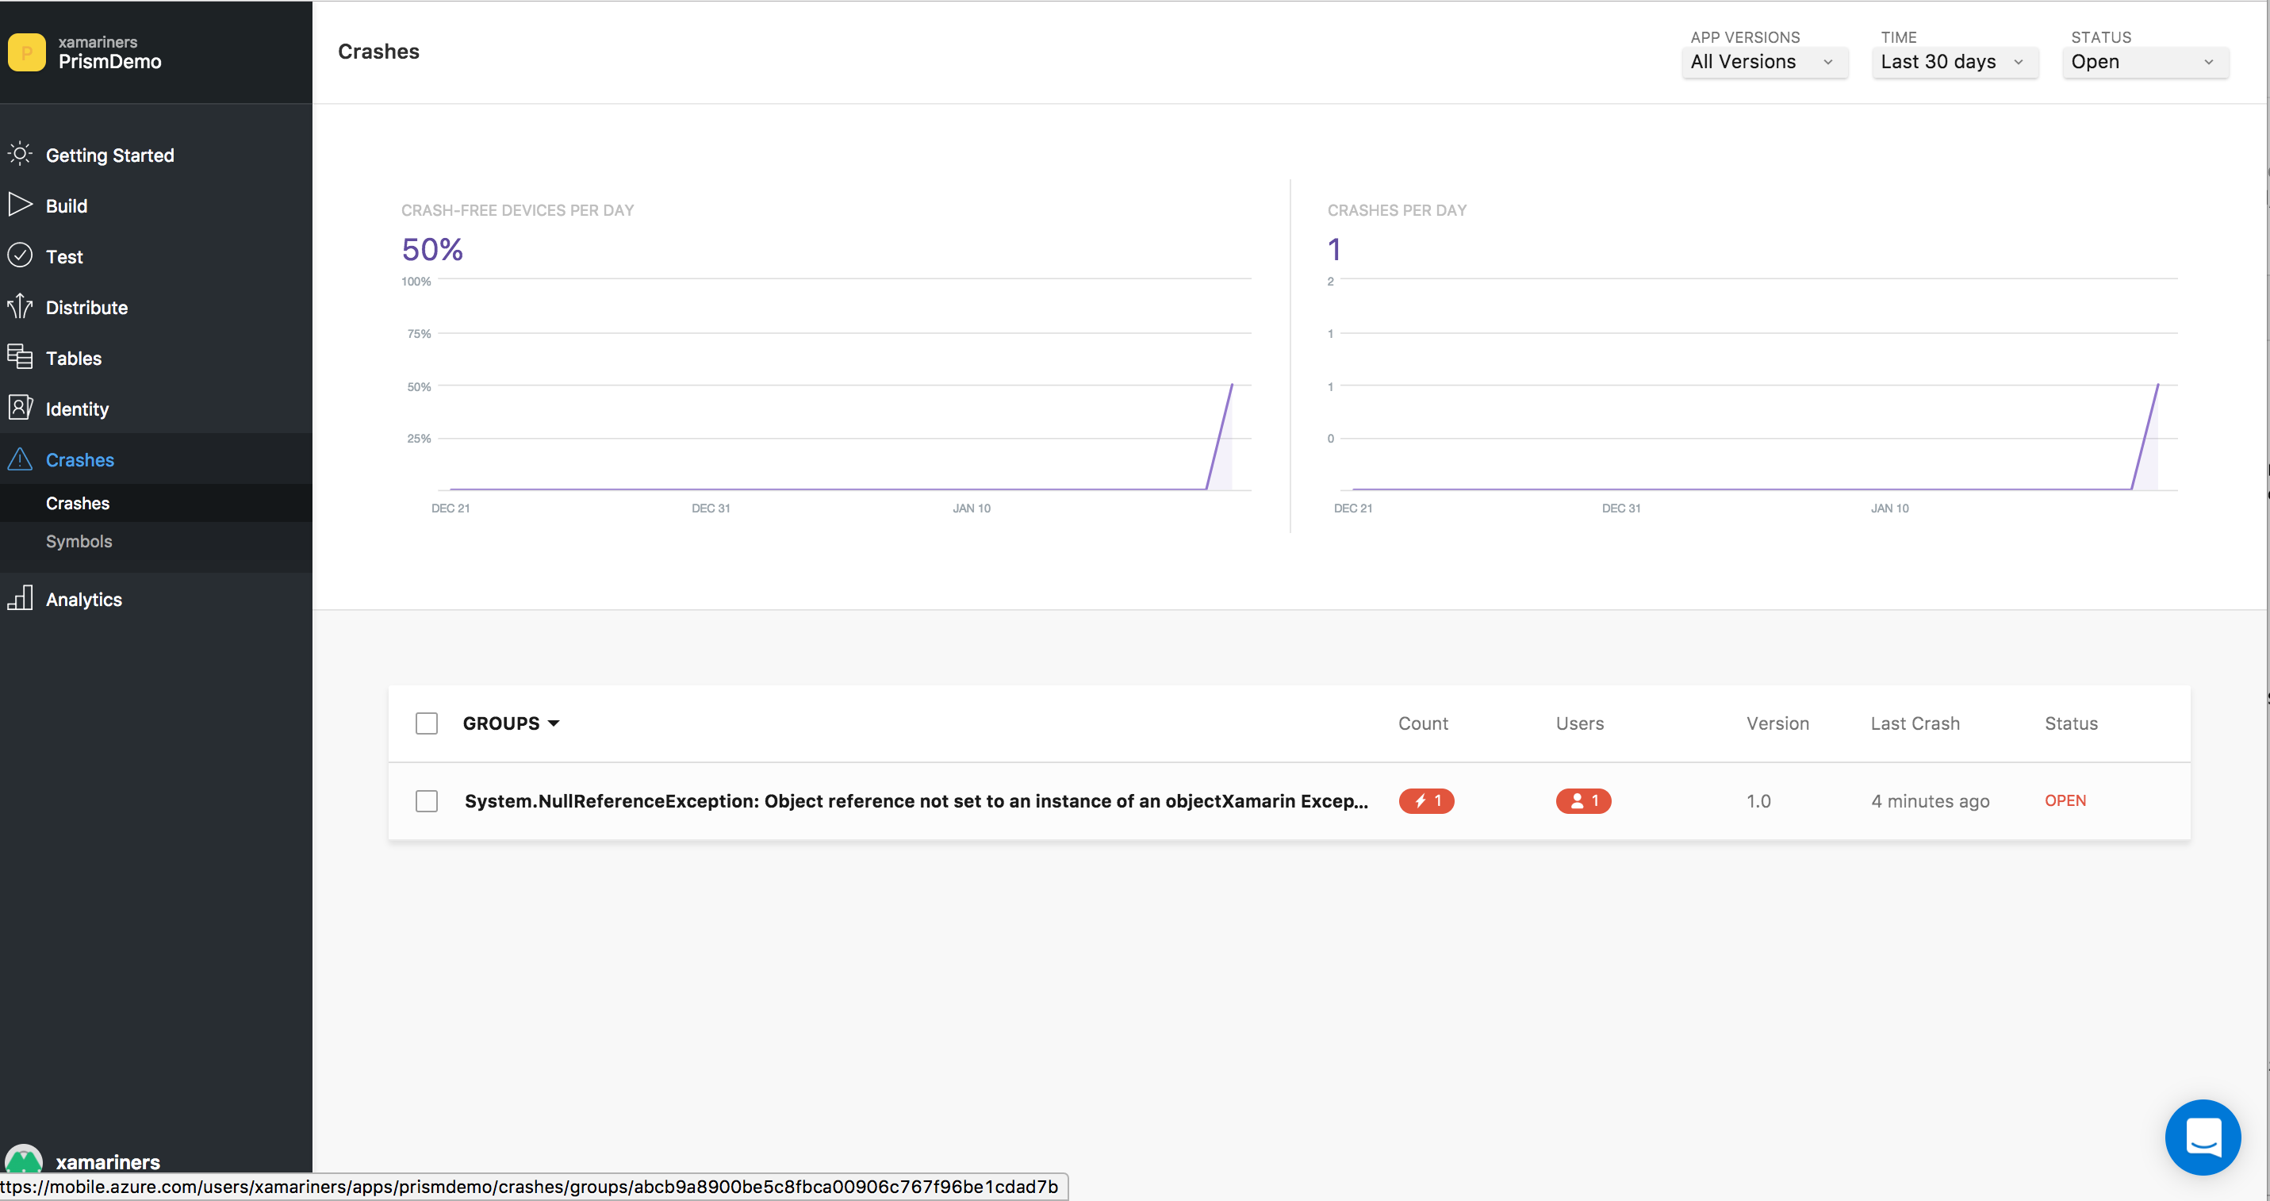


Crashes

Slide 28


Analytics

Slide 29
Api
VSMC is build API first
Anything that can be done on the UI can be done on API
API is actually ahead of UI
API Link: https://docs.mobile.azure.com/api/

Slide 30

Api

Slide 31
More Info
Documentation: https://docs.mobile.azure.com/general/
RoadMap: https://docs.mobile.azure.com/general/roadmap/
Pricing: https://docs.mobile.azure.com/general/pricing/

Slide 32
Thank You! Questions?
Ben Ishiyama-Levy
Microsoft MVP | Xamarin Evangelist
ben@xamariners.com

